Slide 1

NYSPHSAA FLAG FOOTBALL
SPRING 2026 RULES INTERPRETATION
2-7-2026 (Updated 2-11-2026)

Slide 2
AGENDA
Chapter Roll Call
Introductions / Opening Comments
NYSPHSAA FF
  2025-26 NFHS Flag Football Rules Book
NYSACFO Mechanics – 3 & 4 man
Adjournment
2

Slide 3
NYSACFO CHAPTERS
ADIRONACK
CAPITAL DISTRICT
CENTRAL HUDSON
CHAMPLAIN
ELMIRA
FINGER LAKES
LONG ISLAND
MOHAWK VALLEY
PSAL
ROCHESTER
ST. LAWRENCE
SOUTHERN TIER
SOUTHWESTERN
SUFFOLK
SYRACUSE
TRI-VALLEY
WATERTOWN
WESTCHESTER
WESTERN NEW YORK
3

Slide 4
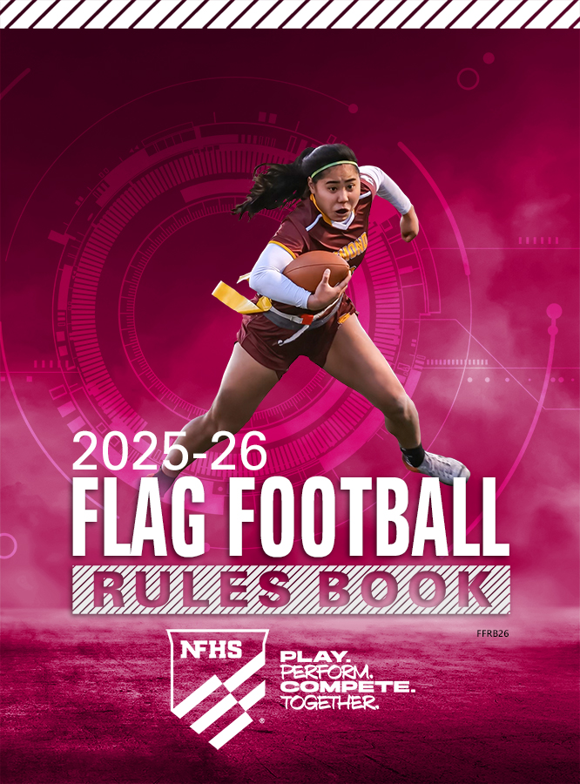
For Spring 2026 the NFHS 2025-26 Flag Football Rules Book is being utilized.
  Modifications per the NYSPHSAA FF Committee
  The rules document from previous seasons is no longer valid.
4

Slide 5
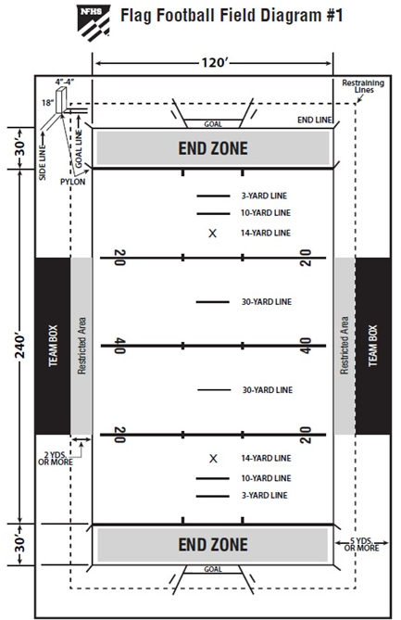
Rule items that will be incorporated into the NYSPHSAA Handbook (by State Adoption)
    Field Size – The field shall be 40 yards in width and 80 yards in length and contain four (4) twenty (20) yard zones with a ten (10) yard end zone on each end. The total field size is 40x100 (including end zones).
  Halftime (3-1-6, page 31)
      10 minutes
      It can be less if both coaches agree
  Field Goals are NOT allowed (8-4-1)
  Overtime (3-1-1 NOTE)
      Post season only
5

Slide 6
OVERTIME IS PLAYED IN POST SEASON ONLY
A coin will be flipped (or odd/even choice) and choice by the visiting team captain will determine the options (as in the start of the game). The winner of the toss shall be given the options of offense, defense, or direction. The loser of the toss shall make a choice of the remaining options. Each overtime period begins with a coin toss (or odd/even choice).
ALL OVERTIME PERIODS ARE PLAYED TOWARD THE SAME GOAL LINE.
Unless moved by penalty, each team will start 1st and goal from the 20-yard line. The object will be to score a touchdown. An overtime period consists of one possession by each team. If the score is still tied after one period, they go to a second period or as many as needed to determine a winner. If the first team which is awarded the ball scores, the opponent still has a chance to win the game. If the defense intercepts the pass or fumble and returns it for a touchdown, they win the game. If they do not return the interception for a touchdown, the ball will belong to the defense, as the offense did not convert their chance. They must convert to win, or another period starts. Each team is entitled to one time-out per overtime period.
Penalties - The offense should be awarded a new series of 4 downs when the penalty for roughing the passer is accepted. Dead ball fouls following a successful try will be penalized from the succeeding spot.
6

Slide 7
2025-26 NFHS FF Rules Differences from 2025 NYSPHSAA FF Rules
Formations (2-12, page 23)
    A scrimmage formation requires a snapper on the line of scrimmage and another offensive player in position to receive the snap. The player in position to receive the snap must be a minimum of 2 yards behind the snapper.
    After the RFP and before the ball is snapped A players must momentarily be 5-yard inbounds (7-2-1, page 45)
    Motion – only one A player may be in motion at the snap and then only if such motion is not toward the opponent’s goal line (7-2-5, page 45)
Ball is Spotted at Foremost Point of the Ball (2-35, page 29)
A fumble in the field of play (forward or backward) that initially touches the ground in the field of play goes to the spot where the ball initially touched the ground (2-35-2, page 29 & 4-2-2g.2, page 38 & 4-3-3, page 39)
A fumble that initially touches the ground in the endzone is a touchback or safety (4-3-1 Exception, Page 39 & 4-3-2, page 39 & 7-4-5, page 46)
7

Slide 8
Fumble Summary
Key to where the ball is next put in play after a fumble is 2-8-2 Field of Play
A fumble (forward or backward) that initially touches the ground in the field of play is dead and spotted where the ball first touched the ground.
A fumble that initially touches the ground in an opponent’s end zone is dead and is a touchback.
Unless momentum applies, a fumble that initially touches the ground in the fumbling team’s own endzone is dead and is a safety.
When a forward fumble goes out of bounds or is ruled out of bounds between the goal lines, the ball shall be returned to the spot of the fumble.
8

Slide 9
2025-26 NFHS FF Rules Differences from 2025 NYSPHSAA FF Rules
Coin Toss
    Option to defer: Direction is now an option (3-2-3, page 31)
2 Minute Warning
    Officials stop the clock (3-4-4e, page 33)
    Inform the teams of time remaining in half (3-3-1, page 32)
        Keep the teams on the field. This is NOT a team time out.
    Clock starts on the snap (3-4-3k, page 33)
It is Delay of Game (DOG) if after receiving the snap during a declared scrimmage kick play, K fails to kick the ball within 5 seconds (3-6-2b, page 36)
A punt that is untouched can be advanced by R (6-1-2, page 42)
    If a punt is touched by a K or R player and then hits the ground; it is dead and belongs to R (6-1-5)
    If a punt touches the ground and then is touched by K, it is “first touching” and remains a live ball. R can take the ball at the most advantageous spot (6-1-7, page 42)
9

Slide 10
2025-26 NFHS FF Rules Differences from 2025 NYSPHSAA FF Rules
Snap (7-1-1, page 44)
    The snapper may be over (above) the ball, but the snapper’s feet must be behind the neutral zone. Only snapper’s hand may be beyond the foremost point of the ball. Also applicable when a sideways snap technique is employed.
On a punt play, neither team can cross the neutral zone until the ball is kicked (7-1-7a, page 44)
No 3 Point Try (Table 8-1, page 47)
Blocking (9-3-1&2, page 51 and 2-3-1&2, page 21)
    Points of Emphasis
        FF is a non-contact sport.
        Up to the defender to avoid contact. Offense can go in the same direction, once beat, they are no longer going in the same direction.
Safety
    Ball is placed at the 30-yard line (9-5-5, page 50 & 4-1-1, page 37)
10

Slide 11
2025-26 NFHS FF Rules Differences from 2025 NYSPHSAA FF Rules
After a Touchdown, a teammate of the scoring player must remove the scorer’s flags in view of the official (8-2-1c, page 48)
    Unsportsmanlike Conduct and disqualification of the head coach per Rule 9-8-1h. This is a previous spot enforcement.
Flag Guarding must involve contact (9-2-2c, page 51)
    The runner shall not use hands, arms or the ball where contact occurs between the runner and an opponent that denies the opportunity for an opponent to pull or remove the flag or flag belt.
11

Slide 12
2025-26 NFHS FF Rules Differences from 2025 NYSPHSAA FF Rules
Flag Checks
    Officials will conduct one dead ball flag check per team at the end of the 1st & 3rd quarter. The athlete will be selected at random by the official.
    If a flag is found to be not within the NFHS standards, the flag check would result in an unsportsmanlike penalty and coach disqualification. (9-8-1h PENALTY, page 55 & 1-5-4)
    Belt Specifications (1-5-1f, page 16)
        Flag Belt rules: 2 pop belts minimum dimension of 14” in length, and the width minimum from the NFHS Rule book of 1½” in width
12

Slide 13
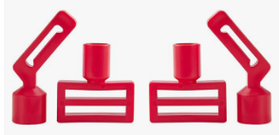
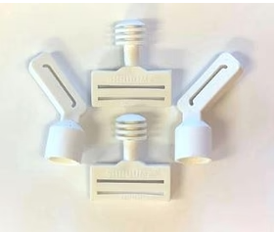
2026 NYSPHSAA Flag Requirement
Flag belt - Each player must wear "pop" flag belts at the waistline with two flags. Each flag must be a minimum of 14 inches from the bottom of the belt to the end of the flag including clip.
Pop
Shruumz
13

Slide 14
2026 NYSPHSAA Uniform Waiver
Waiver to the Uniform specifications as outlined in the NFHS Rules Book for Jersey
    1-5-1.a.2(b)(3)
    1-5-1.a.2(b)(4)
    1-5-1.a.3(b)(3)
    1-5-1.a.3(b)(4)
Waiver to the Uniform specifications as outlined in the NFHS Rules Book for Numbers
    1-5-1.b.3
    1-5-1.b.4
Waiver to the Uniform specifications as outlined in the NFHS Rules Book for Shorts
    1-5-1.d
        *Note: If schools have shorts are not a solid color for the 25-26 season, the flag must be a clearly contrasting color to the shorts and any striping or patterns on the shorts.
14

Slide 15
Loss of Down and Automatic First Down Summary
Loss of Down (LOD) (10-1-6, page 56)
    Illegally handing the ball forward
    Illegal forward pass
    Intentional grounding
Automatic First Down (AFD) (10-1-7, page 56)
    Illegal personal contact as in 9-4
    Noncontact unsportsmanlike conduct by players as in 9-5
    Noncontact unsportsmanlike conduct by nonplayers as in 9-8-1
    Team box and restricted area violations (third and subsequent) as in 9-8-2 and 9-8-3
15

Slide 16
2025-26 NFHS FF - NYSPHSAA Pilot Onside Play
Onside Play Option
    The option is only available to the team behind in score during the final 5 minutes of the 2nd half and only immediately after the trailing team has scored a touchdown or field goal. This option is never available to the team ahead in points.
    This option is not available after the trailing team has scored a safety.
    After the trailing team has scored and attempted the extra point; the team captain of the trailing team must inform the referee they intend to attempt an onside play.
    The ball is placed on the team’s 20-yard line (going out).
    This is a timed down.
    This play is treated exactly like a 4th down play including the assessment of penalties with one exception. If a foul occurs that includes an automatic 1st down (i.e., roughing the passer) the offense will not receive a new set of downs. They will receive the 10-yard penalty and replay the down, (i.e., fourth and ten from the 30-yard line, line to gain is the 40-yard line.)
16

Slide 17
2025-26 NFHS FF - NYSPHSAA Pilot Onside Play
Onside Play Option (cont.)
    The offense must advance the ball to the 40-yard line or beyond, after all live ball penalties have been accessed in order to retain the ball.
    If there is a penalty on A that includes loss of down, the onside down is not replayed.
    Dead ball penalties will not be considered in determining if the line to gain was achieved.
    If the offense does not retain the ball the defense will take possession of the ball where it became dead (end of the run or previous LOS) and the next zone-line-to-gain will be established.
    Interceptions returned to the end zone by the defense during an onside play are worth 6 points and a PAT attempt.
    There is no limit to the amount of onside plays a team may use as long as the provisions of the first 2 bullets on the previous slide are still valid.
    Once the team reaches the 20-yard conversion, the play is blown dead. The team will receive the ball first and zone at their own 20-yard line. If the team does not convert, the ball is spotted where the play is blown dead.
17

Slide 18
2025-26 NFHS FF - NYSPHSAA Pilot Onside Play
Onside Play Option (cont.)
    Ball must be in player possession when the line to gain is made. A forward fumble would come back to the spot of the fumble.
    By rule when A makes the 40-yard line, the ball is live. The clock will stop after ALL onside plays.
    Clock Status and there is no foul on the play.
        If A is successful, the clock is stopped. This gives the officials time to re-set the ball back at the A 20-yard line. Once the ball is re-set at the A 20-yard line, the clock should start on the ready for play.
        If A is not successful, the clock is stopped and should re-start on the next snap. This is a new series for B.
    Clock Status and there is a foul on the play.
        If there are more than two minutes remaining in the game:
            If there is a foul by A or B that results in the onside play being re-played, the clock should start on the ready for play.
            If there is a double foul (live ball fouls on both A and B), by rule the onside play is re-played. The clock should start on the ready for play.
18

Slide 19
2025-26 NFHS FF - NYSPHSAA Pilot Onside Play
  Clock status needs to be considered when on the onside play and there is a foul on the play. (cont.)
      If there are two minutes or less remaining in the game, and there is a foul by A or B, the clock will be determined by the result of the play.
          If there is a foul on B:
            A was successful, A would decline the B penalty. Since the ball was live by rule when the 40-yard line is gained, the clock would start on the ready for play.
            A was unsuccessful, A will want to re-play the onside play.
                If the result of the play ended either out of bounds or was an incomplete pass, the clock would start on the snap.
                If the result of the play ended inbounds, the clock would start on the ready for play.
          If there is a foul on A:
            A was unsuccessful, B would decline the penalty. Since this is a new series for B, the clock would start on the snap.
            A was successful, B will want to re-play the onside play.
                Since the ball was live by rule when the 40-yard line is gained, the clock would start on the ready for play.
19

Slide 20
2025-26 NFHS FF - NYSPHSAA Pilot Onside Play
  Clock status needs to be considered when A utilizes the onside play and there is a foul on the play. (cont.)
      If there are two minutes or less remaining in the game, and there is a foul by A or B, the clock will be determined by the result of the play.
        If there is a double foul, (live ball fouls on both A and B), by rule the onside play is re-played.
            If the result of the play ended either out of bounds or was an incomplete pass, the clock would start on the snap.
            If the result of the play ended inbounds, the clock would start on the ready for play.
      All of the above scenarios for two minutes or less are consistent with regulation timing.
      A live ball and dead ball scenario does not change the above, it just changes where A or B would start the series after the above are considered.
20

Slide 21
2025-26 NFHS FF - NYSPHSAA Pilot Onside Play
        Clock Status
ONSIDE PLAY
> 2:00 REMAINING
≤ 2:00 REMAINING
ANY FOUL BY A OR B THAT REPLAYS ONSIDE
(INCL. DOUBLE FOUL)
READY FOR PLAY
FOUL ON B
FOUL ON A
DOUBLE FOUL (A & B)
A SUCCESSFUL
Ball live when 40 gained
A declines B penalty
READY FOR PLAY
A UNSUCCESSFUL
B declines A penalty
New series for B
SNAP
ONSIDE REPLAYED
OB/INCOMPLETE → SNAP
INBOUNDS → READY
A UNSUCCESSFUL - REPLAY
A accepts B penalty
OOB/INCOMPLETE → SNAP
INBOUNDS → READY
A SUCCESSFUL – REPLAY
Ball live when 40 gained
B accepts A’s penalty
READY FOR PLAY

Slide 22
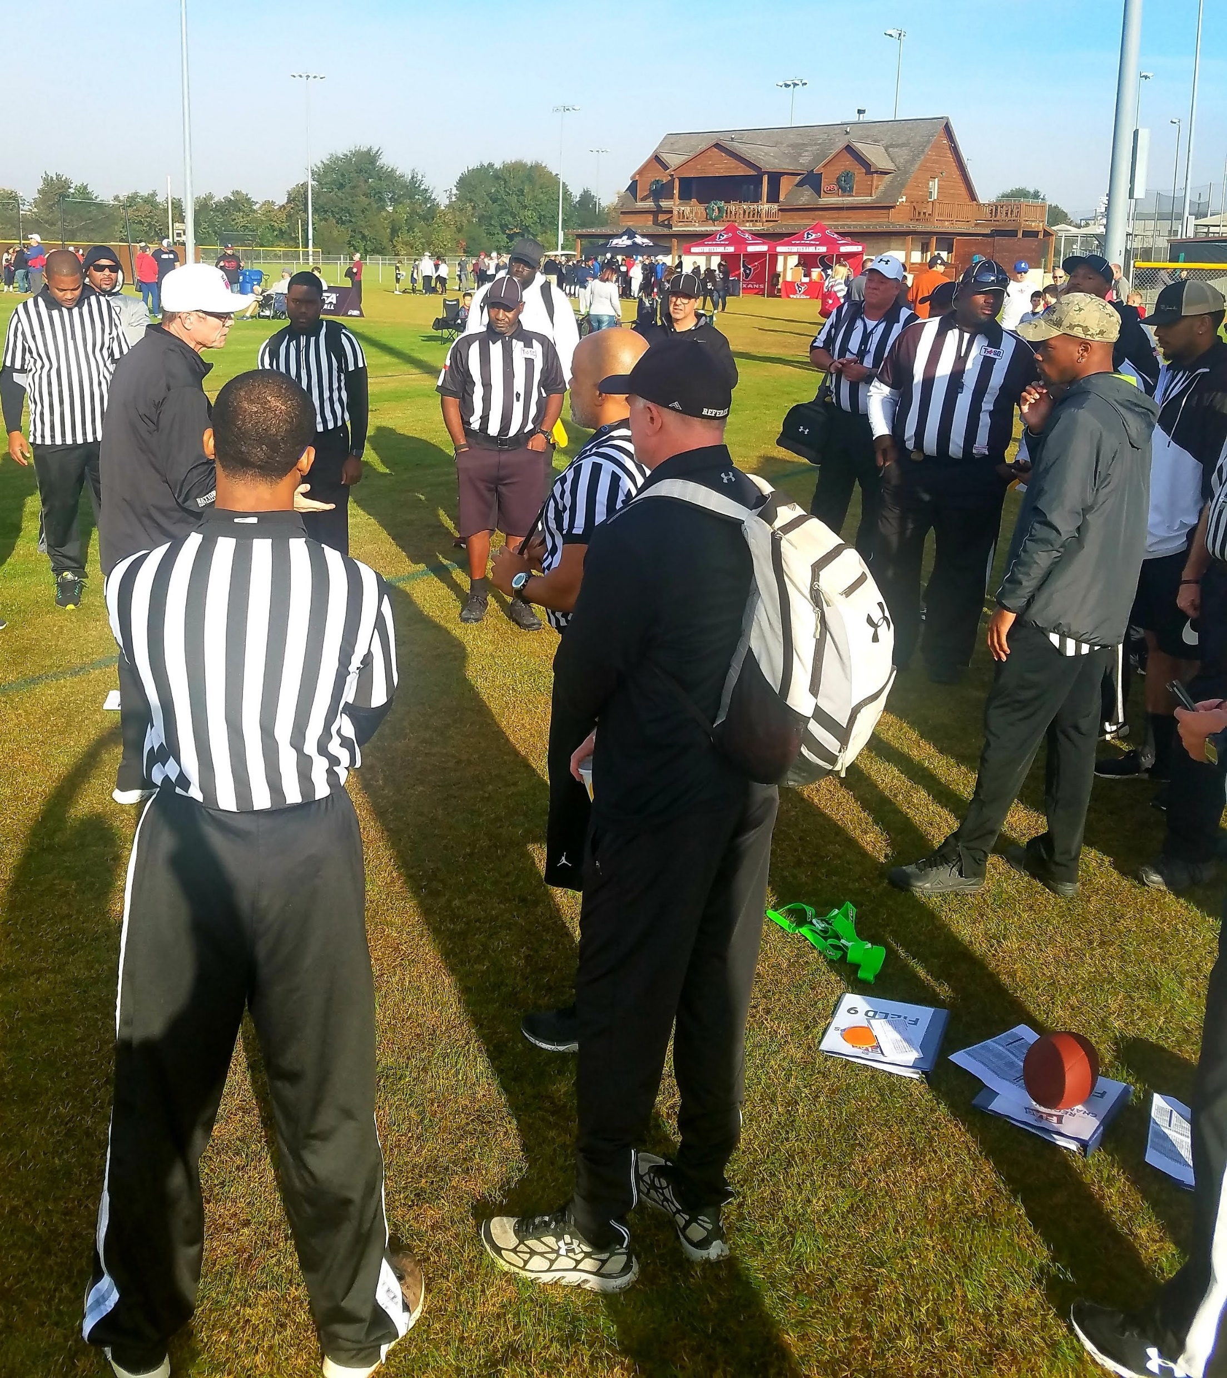
Questions
22

Slide 23

NYSACFO Flag Football Mechanics

Slide 24
Officiating Philosophies
Always box in the play. When in doubt take a position wider and deeper
Signal and verify the down with other officials. Check the down box for accuracy
Communicate the clock status as necessary, especially under 2 minute
Be familiar with the concept of player, zone, ball
Use preventative officiating when possible and avoid game interrupter calls
Make the call when it involves player safety
Conduct a pregame flag and mouthpiece check
24

Slide 25
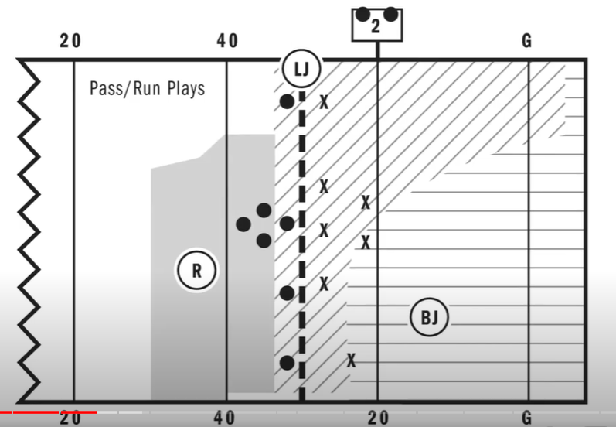





3-Man Scrimmage Play Positions
25

Slide 26
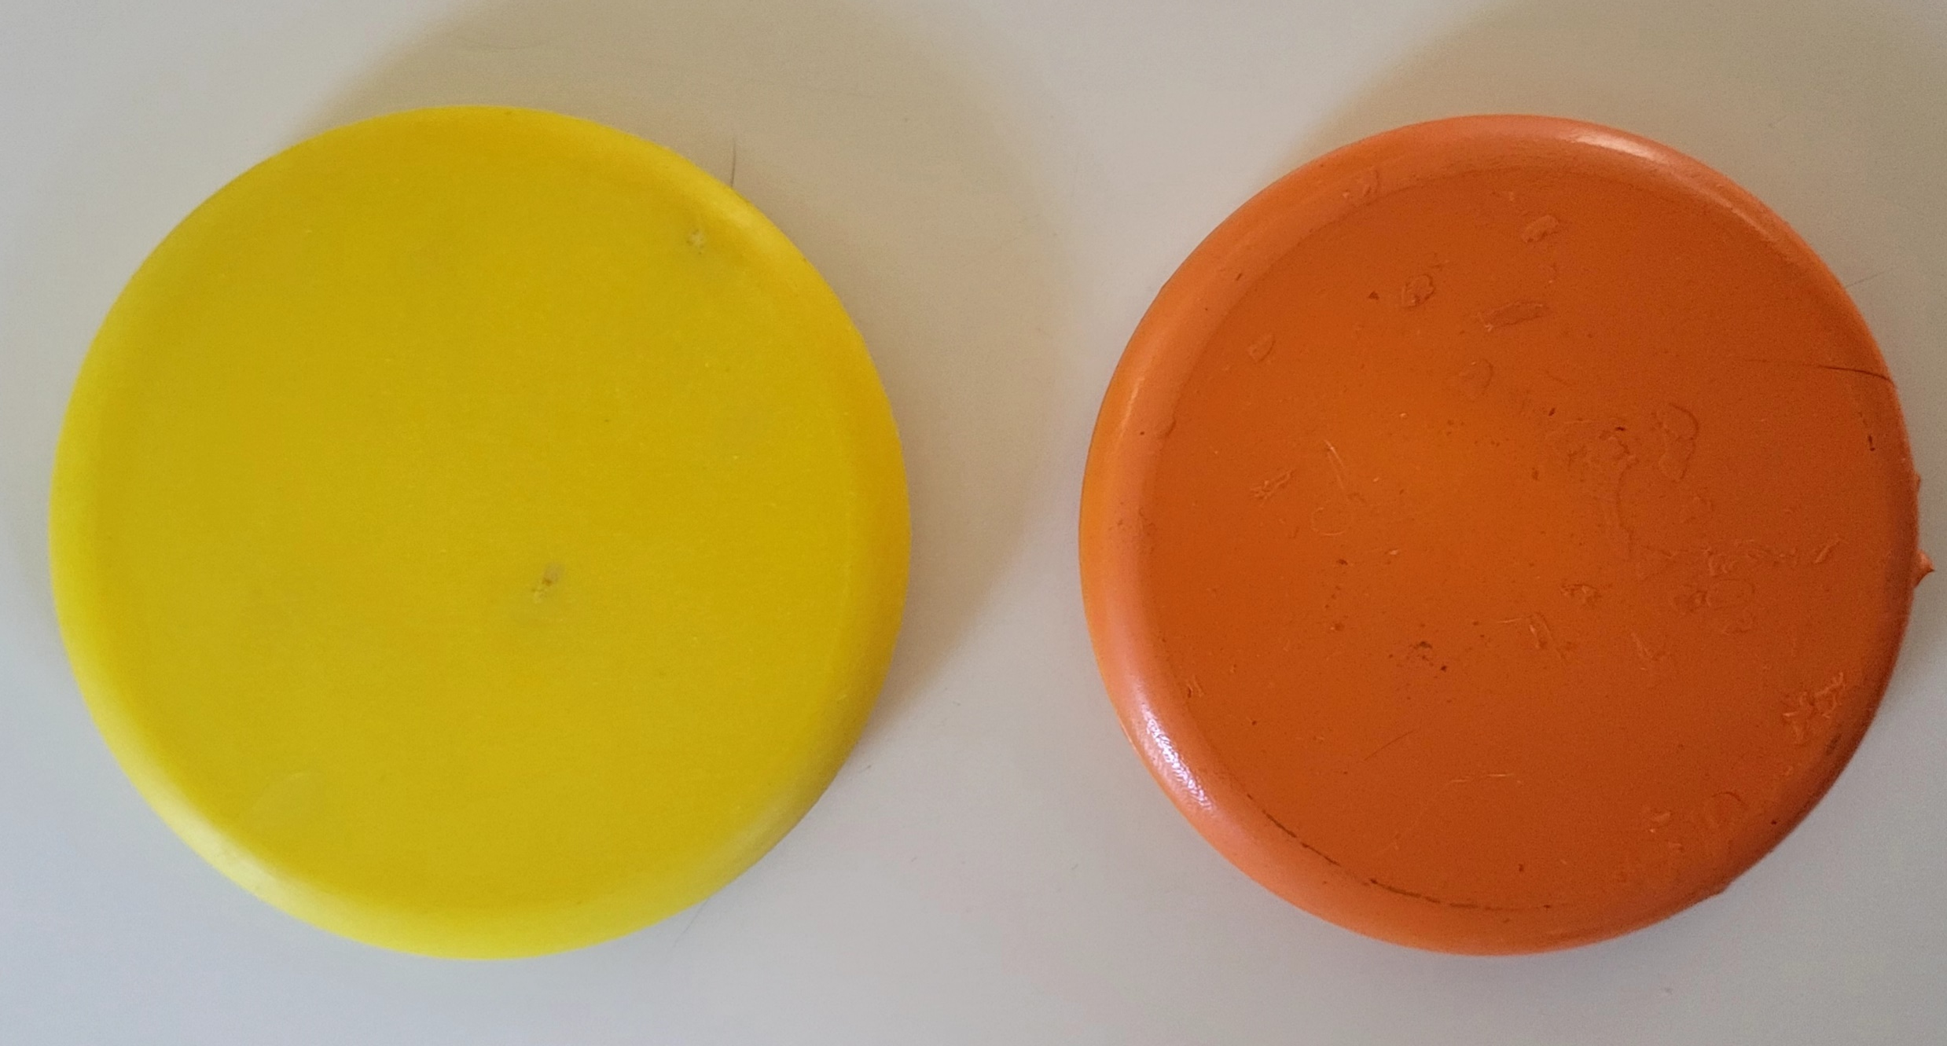
Pre-Snap Referee:
Set the ball spotters to create the neutral zone
Announce down/distance/ LTG, mark the ball ‘Ready for Play’ by blowing it in with signal
‘Ready for Play’ procedure should not prevent a Team from snapping the ball quickly
Start the timing of the play clock (R is responsible for play clock)
Initial position should be approximately 7 yards wide and 7 yards deep from the deepest offensive back and on the opposite side of the field as the Line Judge and same side as the Back Judge
Positioning should be able to see the center, players near the center and backs in your sightlines. Alert to false starts and illegal shifts
Communicate when play clock gets to 10 seconds with signal and chop out 5,4,3,2,1
  verbal count is optional
26

Slide 27
Pre-Snap Line Judge:
Finishing previous play. Mark forward progress spot with downfield foot and signal next down. Bring the ball into the spot, communicate down and distance to the down box.
Take initial position between the neutral zone on the boundary opposite the R and BJ. Widen position as players press the boundary in their pre-snap alignment
Sightlines: neutral zone, players on both sides of the LOS. Alert for players entering and exiting (be aware of substitutes)
Alerts: encroachment, false starts, illegal snaps, illegal formations, illegal shifts, illegal motions. Take responsibility for players in motion
27

Slide 28
Pre-Snap Back Judge:
Upon conclusion of the previous play, if necessary, mark the forward progress spot and pass on to the LJ for the next LOS
Initial position is opposite boundary of the LJ at least 20 yards downfield and 5 yards deeper than the deepest defender.
On the boundary NOT 5 yards on the field of play.
Wider is better and can press the play as it dictates following your reads
Alert for players entering and exiting (be aware of substitutes)
Communicate the clock status when needed
28

Slide 29
4-Person: Field Judge
assumes 3-person BJ position keys
Helps spots ball along with Line Judge when the play ends on the opposite side of the field.
4-Person: Back Judge
Initial position is opposite of the FJ on LJ side of the field, at least 25 yards downfield and 5 yards deeper than the deepest defender. 15 yards off the boundary
29

Slide 30
Reading and understanding initial keys:
Referee:
QB, players and blockers in the backfield. Dead ball equipment enforcement
Line Judge:
Snapper, all players lined up on their respective LOS and receivers on your boundary. Dead ball equipment enforcement
Back Judge:
Receivers on your boundary and field side of the snapper. Dead ball equipment enforcement
4-Person Crew:
Field Judge:
  Receivers on your boundary and field side of the snapper. Dead ball equipment enforcement
Back Judge:
  Receivers to both boundaries. Dead ball equipment enforcement
30

Slide 31
Passing and Running Plays Referee:
Ready to rule on snap if it strikes the ground. After the snap observe action behind the neutral zone eyes on the QB and blockers around the QB/ runner
Mark forward progress if play ends behind the LOS
Assist the BJ with runners going out of bounds on your boundary
Once ball is advanced beyond the LOS remain near the neutral zone to rule on plays from trailing position behind the ball
Remain wider and deeper than the QB aware of potential backward passes to another passer. If pass is not thrown immediately, responsible for ruling on all passes behind the LOS. If in doubt, the pass is backward
When forward pass is thrown announce “Ball is Away” with eyes on the passer until no threat of a foul. If a flag pull occurs at the same time arm is moving forward, pass was away before flag pull (distance from flag to arm to rule on if pass was away is tough).
Primarily responsible for roughing the passer and intentional grounding
Press the LOS with the passer to rule on the legality of the pass. If in doubt, the pass is legal
31

Slide 32
Passing and Running Plays Line Judge:
Post snap, hold your position for 1 count to observe initial charge of the line players to rule on contact created by either team.
Run read: Hold at the neutral zone and observe blockers and defenders around the ball. If pass is thrown immediately rule on the direction.
Pass read: Move downfield 3-5 yards with eyes on the middle of the field and receivers pressing your boundary
Once the forward pass is thrown work to position between the receiver and defender keeping ‘outside in’ look of the play
As the runner crosses the LOS stay parallel with the runner to rule on all backward passes beyond the LOS. Mark forward progress past the neutral zone and responsible for your sideline from end line to end line
Mark the ball while the Referee brings up the markers
32

Slide 33
Passing and Running Plays Back Judge 3-Person:
After the snap hold your position for a 1 count to observe movement of initial keys
Run read: Observe blockers around runner and retreat to boundary as the ball presses your sideline Note: Refer to your chosen mechanic recommended or otherwise
Pass Read: Retreat as receivers establish patterns. Don’t allow players to get behind you. Once the pass is thrown work to get in position between the receiver and the defender
Passing and Running Plays Back Judge 4-Person
After the snap hold your position for a 1 count to observe movement of initial keys
Run read: Observe blockers around runner and retreat as the ball presses your position
Pass Read: Retreat as receivers establish patterns. Don’t allow players to get behind you. Once the pass is thrown work to get in position
Field Judge:
Field Judge: Position, coverage and responsibilities are the same as back judge 3-person on other scrimmage plays
33

Slide 34
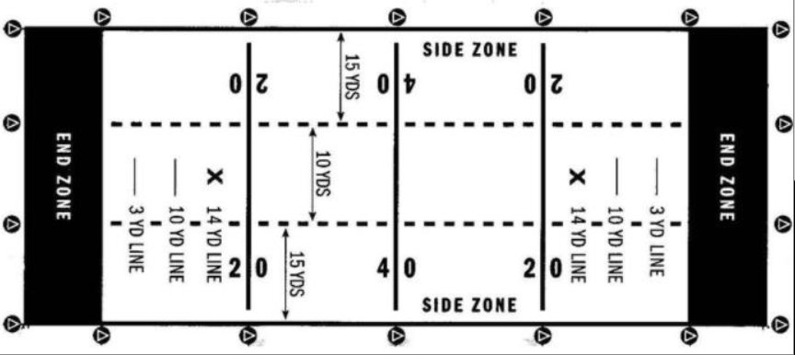
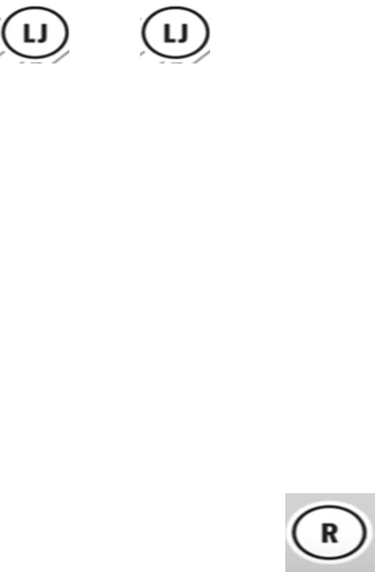
3rd and 4th Down Line to Gain coverage 3-person
Referee: Position, coverage and responsibilities are the same as other scrimmage plays
Line Judge: Pre-snap position and keys remain the same. If the ball is snapped 10 yards or less from the line-to-gain move quickly to LTG. Hold there to rule on 1st down or forward progress short. Travel as the runner travels beyond the LTG to dead ball.
Back Judge: Position, coverage and responsibilities are the same as other scrimmage plays
34

Slide 35
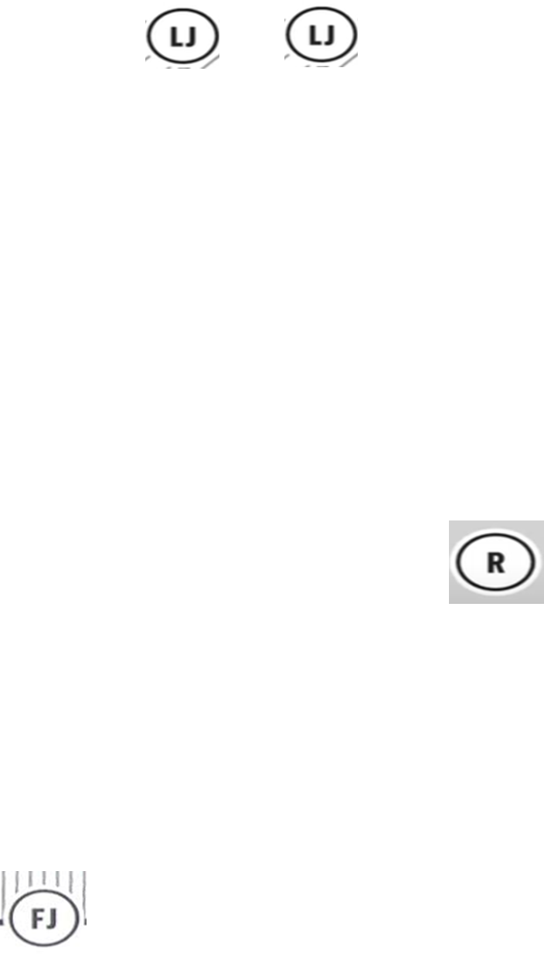
3rd and 4th Down Line to Gain coverage 4-person
Referee: Position, coverage and responsibilities are the same as other scrimmage plays
Line Judge: Pre-snap position and keys remain the same. If the ball is snapped 10 yards or less from the line-to-gain move quickly to LTG. Hold there to rule on 1st down or forward progress short. Travel as the runner travels beyond the LTG to dead ball.
Field Judge: Position, coverage and responsibilities are the same as other scrimmage plays
Back Judge: Position, coverage and responsibilities are the same as other scrimmage plays
35

Slide 36
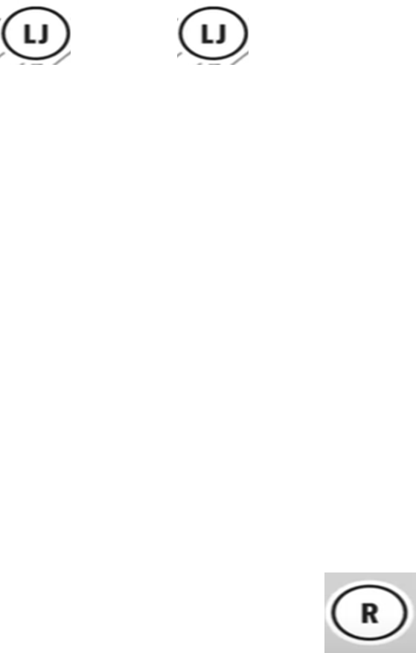
Goal Line and PAT Conversion coverage: 3-Person
Referee: Pre-snap position, keys and coverage responsibilities are the same
Line Judge: Pre-snap position and keys remain the same. If the ball is snapped on the 10 yard-line or inside move to the goal line immediately to rule on plays from there.
Back Judge: Pre-snap position remains the same. If the ball is snapped on the 10 yard-line or in, position on the end line and off the boundary. Hold position until dead ball or change of possession.
36

Slide 37
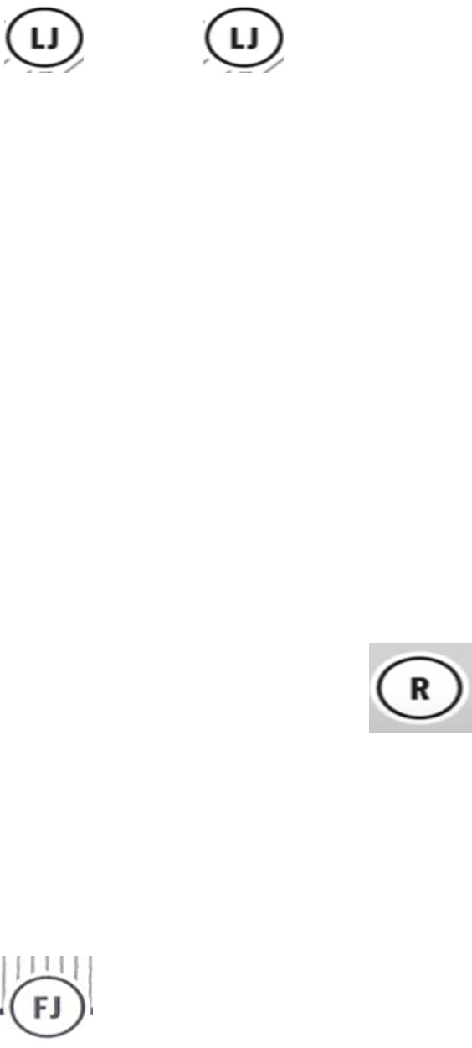
Goal Line and PAT Conversion coverage: 4-Person
Referee: Pre-snap position, keys and coverage responsibilities are the same
Line Judge: Pre-snap position and keys remain the same. If the ball is snapped on the 10 yard-line or inside move to the goal line immediately to rule on plays from there.
Field Judge: Hold the goal line and off the boundary
Back Judge: Pre-snap position remains the same. If the ball is snapped on the 10 yard-line or in, position on the end line middle. Hold position until dead ball or change of possession.
37

Slide 38
Punt Plays Referee:
Prior to 4th down plays ask the team captain or coach do they want to punt or play. Communicate the decision, mark and signal the ball ‘Ready for Play’.
Notify all players to stay out of the neutral zone until the ball is punted
Initial position and keys remain the same
Watch for the snap hitting the ground and the punter kicking the ball
38

Slide 39
Punt Plays Line Judge:
Initial position and keys remain the same
Post snap hold your position to rule on the play from there eyes on neutral zone infraction before the kick
Rule on if the kick crosses the LOS
Assist with the spot if the ball goes out of bounds
Kick in the air move downfield and observe blockers and runner maintaining your boundary
39

Slide 40
Punt Plays Back Judge:
Initial position the same but move at least 3-5 yards behind the deepest receiver.
If that is on or inside the 10 move to the goal line.
After the snap keep your angle with the receiver. Once the ball is caught mark the kick end spot with bean bag. Observe blockers and responsible for the goal line to rule on touch backs and balls hitting the ground.
Balls out of bounds on the ground or in flight mark the spot.
Balls breaking the plane of the goal line, either in the air or on the ground, are dead and ruled touchbacks.
40

Slide 41
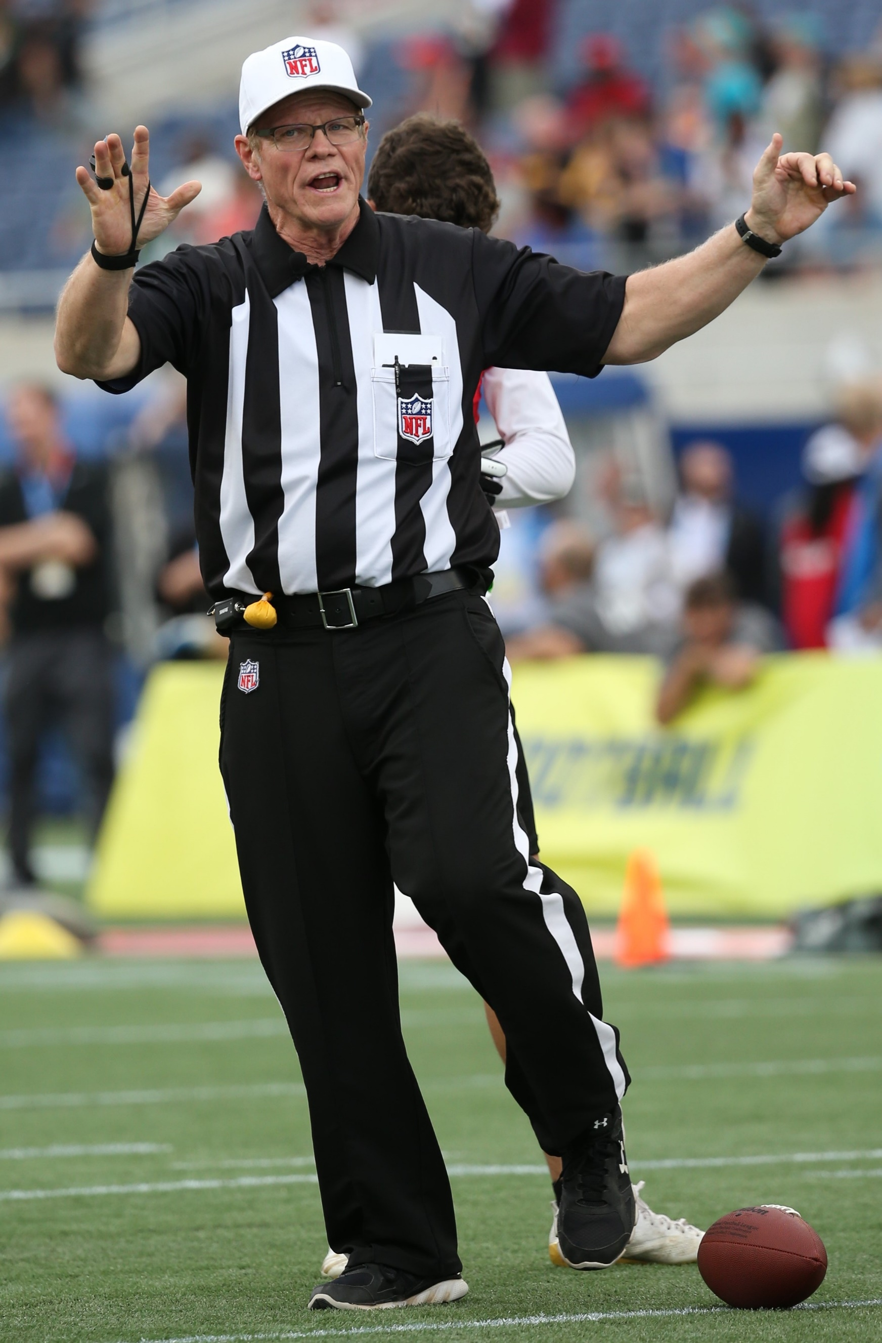
Approach to Penalty Enforcement
Be professional and courteous at all times
Know the rules and penalty enforcement
Take into account the age and skill level.
Be proactive in communication with coaches and players
Enforce the restricted area
Enforce the rules with eye on player safety
Make the call when it involves player safety
Avoid ‘By the Book’ or game interrupter calls
Have a defined penalty announcement progression in place
What? Who? Result. Verbal and by signal
41

Slide 42
Penalties
A runner shall not charge into nor contact an opponent in their path or attempt to run between 2 opponents Stay in front of rough play don’t chase it
Flag guarding is the attempt by the ball-carrier to obstruct the defender access to the flags by stiff arming, dropping the hand, arm, shoulder or head or intentionally covering the flags with the football or jersey. It is Illegal to pull flags off a player who doesn’t have possession
Roughing the passer by the defense is an automatic first down
Illegal forward pass committed by the offense is loss of down
Illegal equipment is a 10-yard penalty. All USC and personal fouls are 10 yards
Disqualification
Flagrant unsportsmanlike conduct: Fighting, leaving the box to enter the field during fight, intentionally contacting an official
Flagrant personal foul: tackling a ballcarrier, fighting an opponent, leaving the sideline to participate while the play is live (Nonplayer)
42

Slide 43
Questions
43

Slide 44
THANK YOU!

