Slide 1

2025 INTERPRETATION MEETING
July 27, 2025

Slide 2
MEETING AGENDA
Welcome, Introductions and Announcements
2025 Rules Change
2025 Equipment Items
2025 Editorial Changes
2025 Rules Reminders
2025 Points of Emphasis
2024 - 2025 Game Officials Manual Update
Closing Comments

Slide 3
2025 Themes
EXCELLENCE
  BE Prepared to do your very best every game
  ”Strive for Excellence not Perfection”
CONSISTENCY
  Steadfast adherence to the approved officiating mechanics from the first game thru the last game, 1st Quarter thru the 4th Quarter, and from Section 1 thru Section 11
HAVE FUN
  Enjoy the Process of Learning the Rules and Mechanics, Enjoy the On-Field Challenges, Enjoy the Teamwork

Slide 4
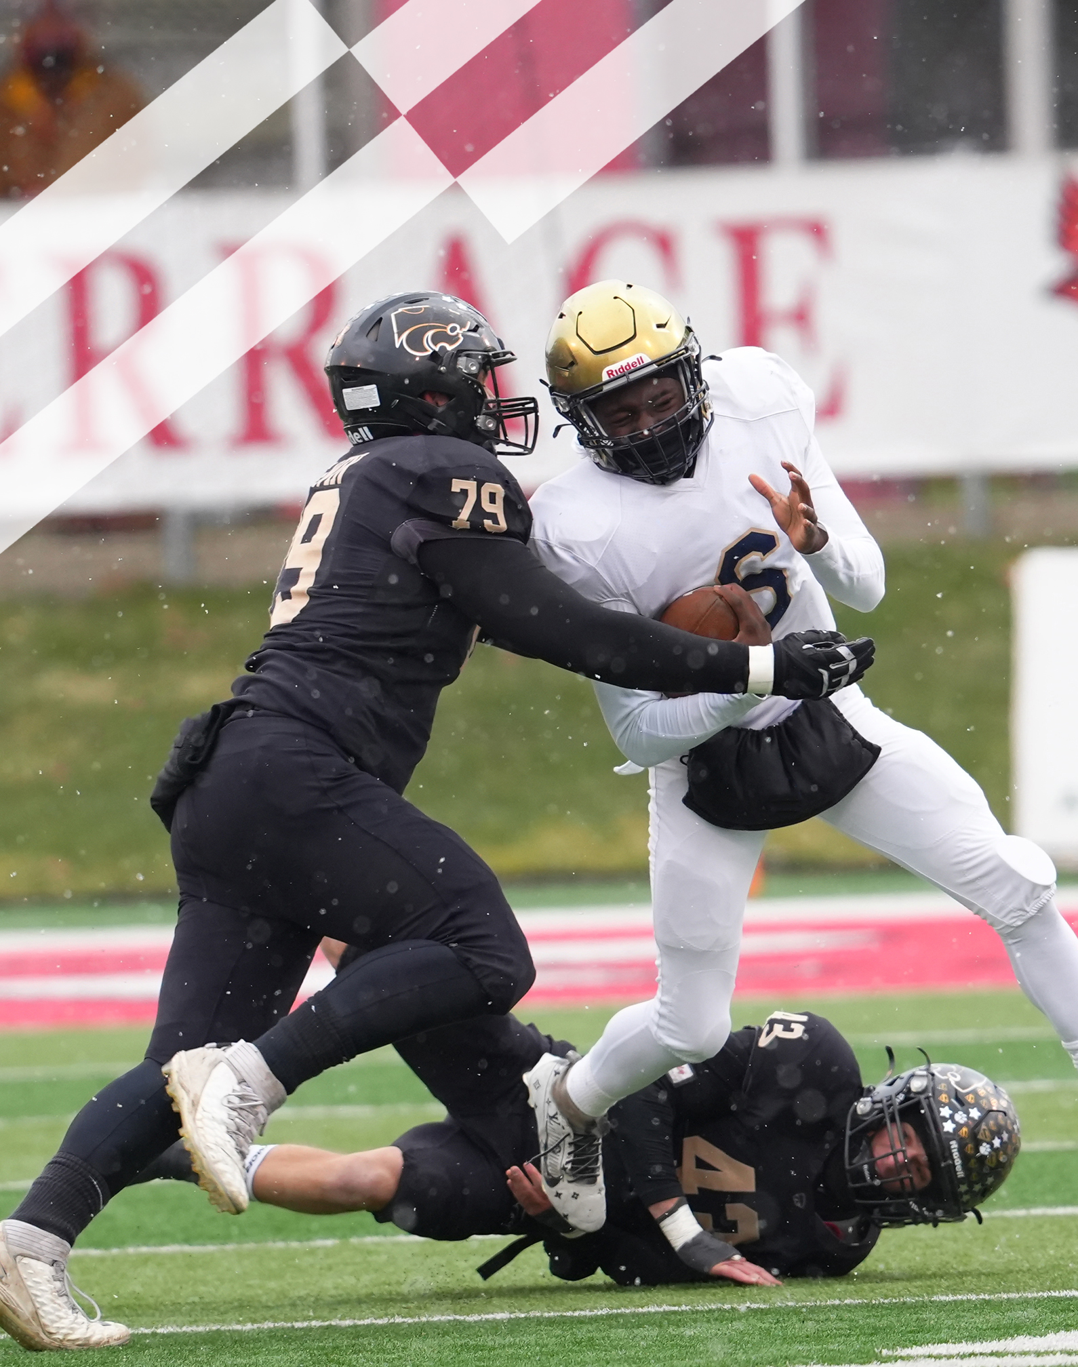
2025 NFHS FOOTBALL RULES POWERPOINT
Notes:
“In The Huddle” Bill Curry
This PowerPoint presentation from the National Federation of State High School Associations (NFHS) covers the following:
2025 NFHS Football Rules Changes-
2025 NFHS Football Editorial Changes-
2025 NFHS Football Points of Emphasis-
2025 NFHS Football Rules Reminders-
2025-26 NFHS Football Information-

Slide 5
NFHS INFORMATION

Slide 6
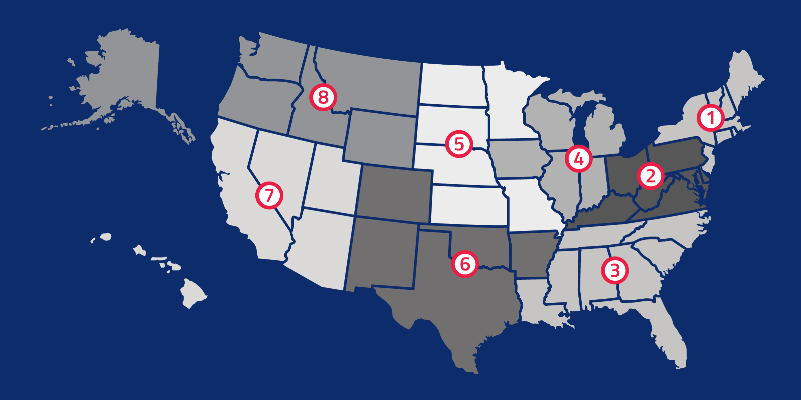
National Federation of State
High School Associations
NFHS (located in Indianapolis, IN – Est. 1920):
  National leader and advocate for high school
  athletics and performing arts programs.
  Serves 51 state associations, 19,800 high
  schools and 12 million student participants.
  Writes playing rules for 18 high school
  sports for boys and girls.
  Offers online education courses for high
  school coaches, officials, parents, students and others.
  Ensures that students have opportunity to enjoy healthy participation, achievement and good sportsmanship in education-based activities.
Notes:
Comment on Slide:
Overview of the NFHS.

Slide 7
2025 NFHS FOOTBALL RULES CHANGES

Slide 8
NFHS FOOTBALL RULES
Each state high school association adopting these NFHS football rules is the sole and exclusive source of binding rules interpretations for contests involving its member schools. Any person having questions about the interpretation of NFHS football rules should contact the football rules interpreter designated by the respective state high school association.
The NFHS is the sole and exclusive source of model interpretations of NFHS football rules. State rules interpreters may contact the NFHS for model football rules interpretations. No other model football rules interpretations should be considered.
Notes:
Comment on Slide:
This statement appears at the bottom of page three in the 2025 NFHS Football Rules Book.

Slide 9
TOOTH & MOUTH PROTECTOR
Notes:
Comment on Slide:
This statement appears at the bottom of page three in the 2025 NFHS Football Rules Book.

Slide 10
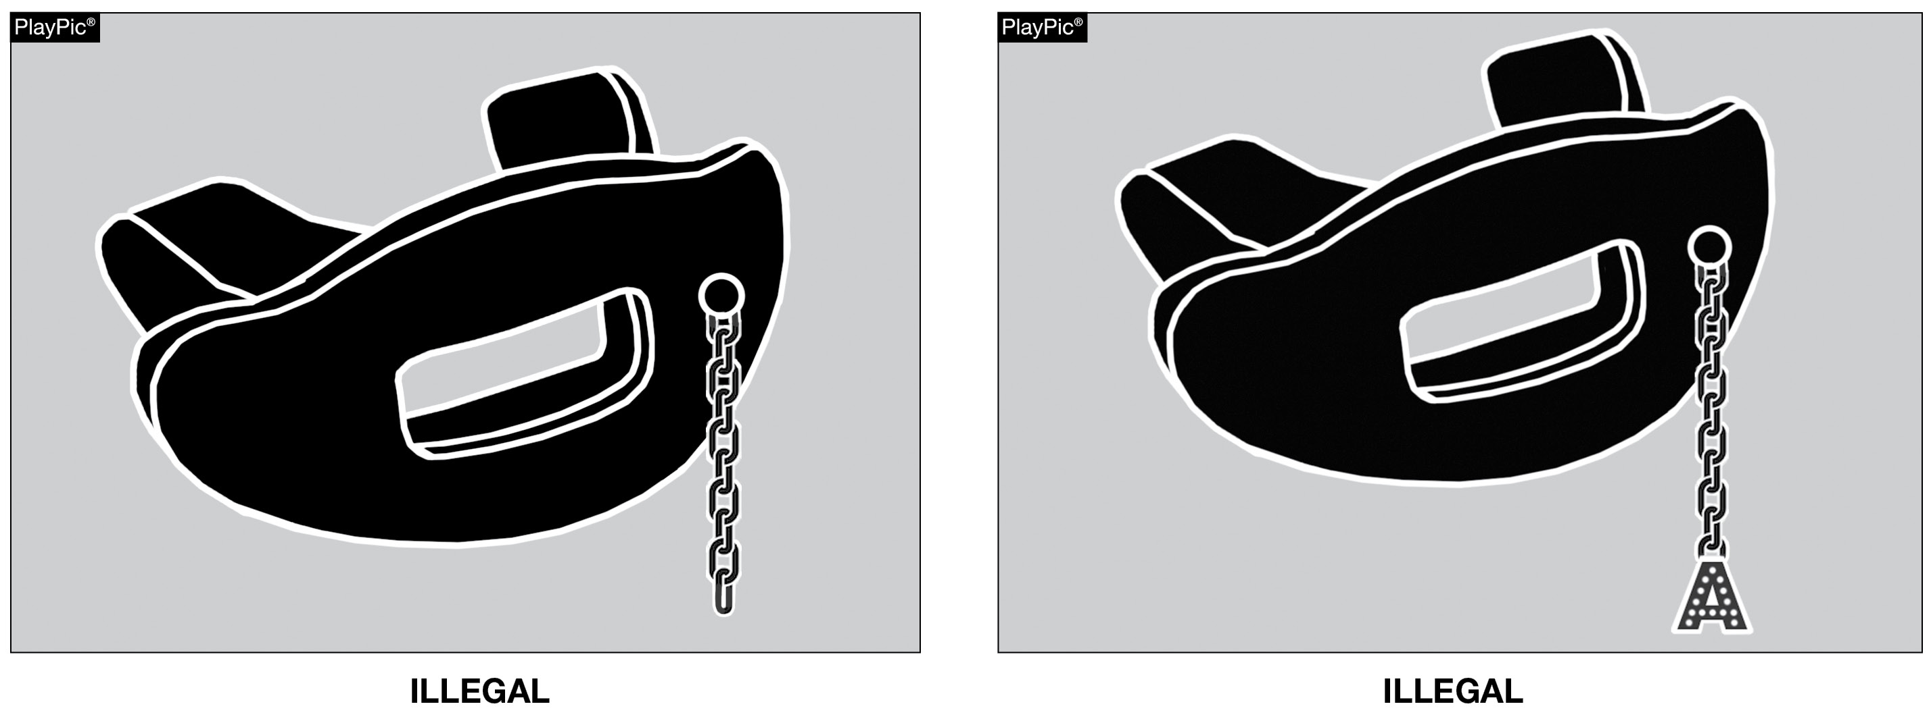
TOOTH & MOUTH PROTECTOR
RULE 1-5-1d(5)a – 4 (NEW)
Effective 2026: Tooth and mouth protectors may not include any attachment(s) that do not serve a purpose and function in protecting the teeth or mouth.
Notes:
Rules Changes:
RULE 1 – SECTION 5 PLAYER EQUIPMENT
ART. 1 . . . Mandatory equipment. Each player shall participate while wearing the following pieces of properly fitted equipment, which shall be professionally manufactured and not altered to decrease protection: …
d. Pads and Protective Equipment – The following pads and protective equipment are required of all players: …
5. (a) A single tooth and mouth protector (intraoral) which shall:
(1) include an occlusal (protecting and separating the biting surfaces) portion;
(2) include a labial (protecting the teeth and supporting structures) portion;
(3) cover the posterior teeth with adequate thickness;
(4) not include any attachment(s) that do not serve a purpose and function in protecting the teeth or mouth (effective 2026); and
(5) not include anything on it that is a health or risk issue and can pose a danger to themselves or other players (effective 2026).
(b) It is recommended that the protector be properly fitted, protecting the anterior (leading) dental arch and:
(1) constructed from a model made from an impression of the individual’s teeth; or
(2) constructed and fitted to the individual by impressing the teeth into the tooth and mouth protector itself. …
Rationale for Change: Items that are attached to the tooth and mouth protector that do not serve a purpose and function in protecting the teeth or mouth will not be allowed.

Slide 11
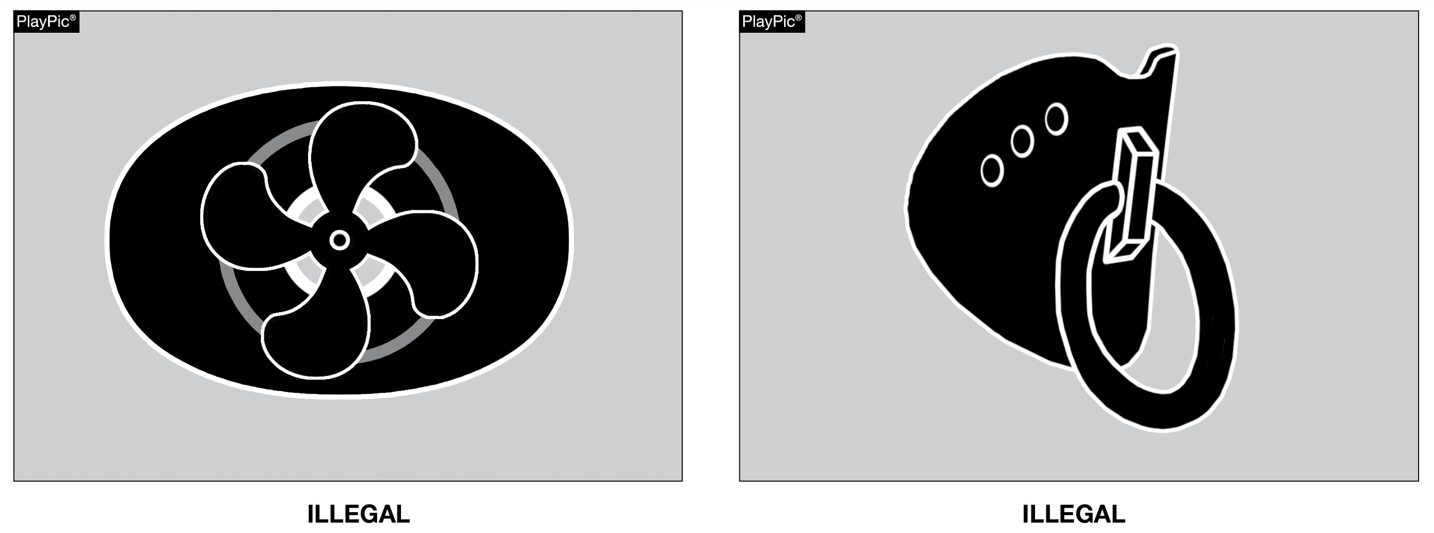
TOOTH & MOUTH PROTECTOR
RULE 1-5-1d(5)a – 5 (NEW)
Effective 2026: Tooth and mouth protectors may not include anything on them that is a health or risk issue and can pose a danger to themselves or other players.
Notes:
Rules Changes:
RULE 1 – SECTION 5 PLAYER EQUIPMENT
ART. 1 . . . Mandatory equipment. Each player shall participate while wearing the following pieces of properly fitted equipment, which shall be professionally manufactured and not altered to decrease protection: …
d. Pads and Protective Equipment – The following pads and protective equipment are required of all players: …
5. (a) A single tooth and mouth protector (intraoral) which shall:
(1) include an occlusal (protecting and separating the biting surfaces) portion;
(2) include a labial (protecting the teeth and supporting structures) portion;
(3) cover the posterior teeth with adequate thickness;
(4) not include any attachment(s) that do not serve a purpose and function in protecting the teeth or mouth (effective 2026); and
(5) not include anything on it that is a health or risk issue and can pose a danger to themselves or other players (effective 2026).
(b) It is recommended that the protector be properly fitted, protecting the anterior (leading) dental arch and:
(1) constructed from a model made from an impression of the individual’s teeth; or
(2) constructed and fitted to the individual by impressing the teeth into the tooth and mouth protector itself. …
Rationale for Change: Items that are a part of the tooth and mouth protector that are a health or risk issue to the player and can pose a danger to themselves or other players, will not be allowed.

Slide 12
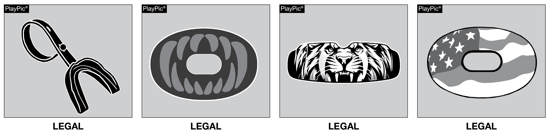
TOOTH & MOUTH PROTECTOR
RULES 1-5-1d(5)a – 4, 5 (NEW)
These tooth and mouth protectors neither include any attachment(s) that does not serve a purpose and function in protecting the teeth or mouth, nor anything that is a health or risk issue posing a danger and are not impacted by this rule change.
Notes:
RULES CHANGES:
See comments on slide

Slide 13
ARM SLEEVES
Notes:
Comment on Slide:
This statement appears at the bottom of page three in the 2025 NFHS Football Rules Book.

Slide 14
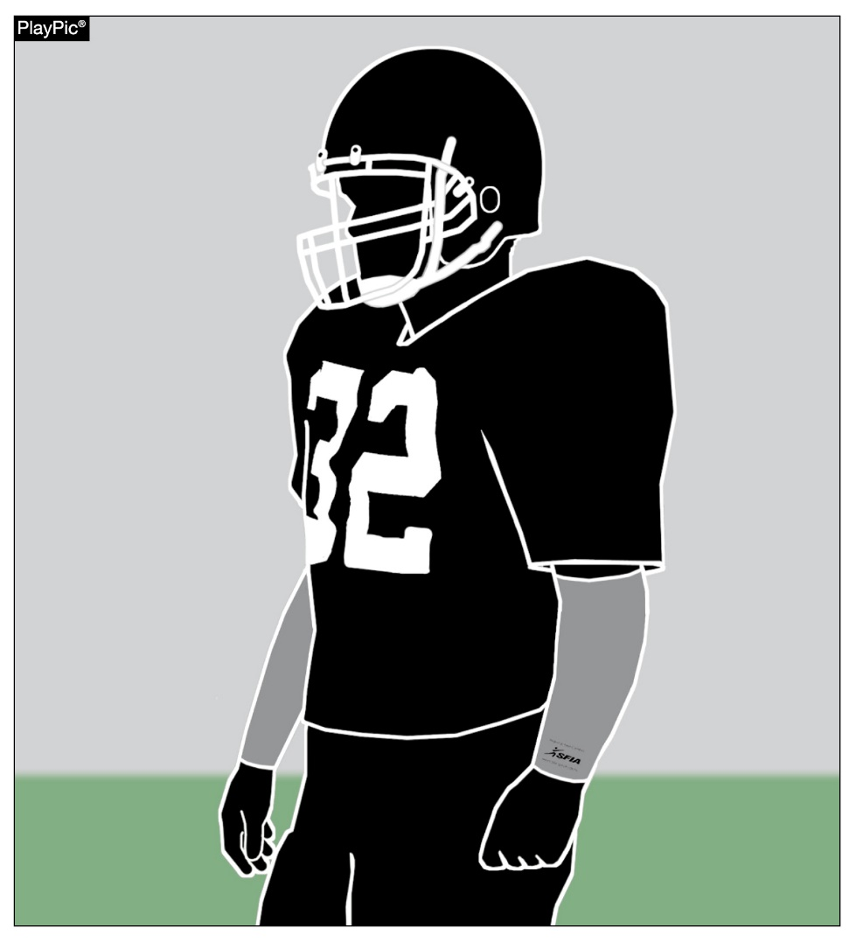
ARM SLEEVES
RULES 1-5-2d (NEW), 1-5-3c(6)
Effective 2027: Arm sleeves, whether attached to a shirt or unattached, manufactured to enhance contact with the football or opponent must meet the SFIA Specification at the time of manufacture.
Notes:
Rules Changes:
RULE 1 – SECTION 5 PLAYER EQUIPMENT
ART. 2 . . . The following auxiliary equipment may be worn if sanctioned by the umpire as being soft, nonabrasive, nonhardening material: …
d. Effective 2027, arm sleeves, whether attached to a shirt or unattached, manufactured to enhance contact with the football or opponent must meet the SFIA Specification at the time of manufacture. Arm sleeves must have a permanent exact replica of the SFIA arm sleeve seal (meets SFIA Specification) (Figure 1-5-2d), that must be visible and appear legibly on the exterior of the arm sleeve.
ART. 3 . . . Illegal equipment. No player shall participate while wearing illegal equipment. This applies to any equipment, which in the opinion of the umpire is dangerous, confusing or inappropriate. Illegal equipment shall always include but is not limited to: …
c. The following Other Illegal Equipment: …
6. Jerseys, undershirts or exterior arm covers/pads manufactured to enhance contact with the football or opponent (through 2026). Effective 2027, jerseys or pads manufactured to enhance contact with the football or opponent. …
Rationale for Change: The Sports and Fitness Industry Association (SFIA), in working with the football arm sleeve manufacturers and the NFHS, has developed new football arm sleeve performance specifications to be effective with the 2027 playing season. These new specifications closely align with the current rules for football gloves.

Slide 15
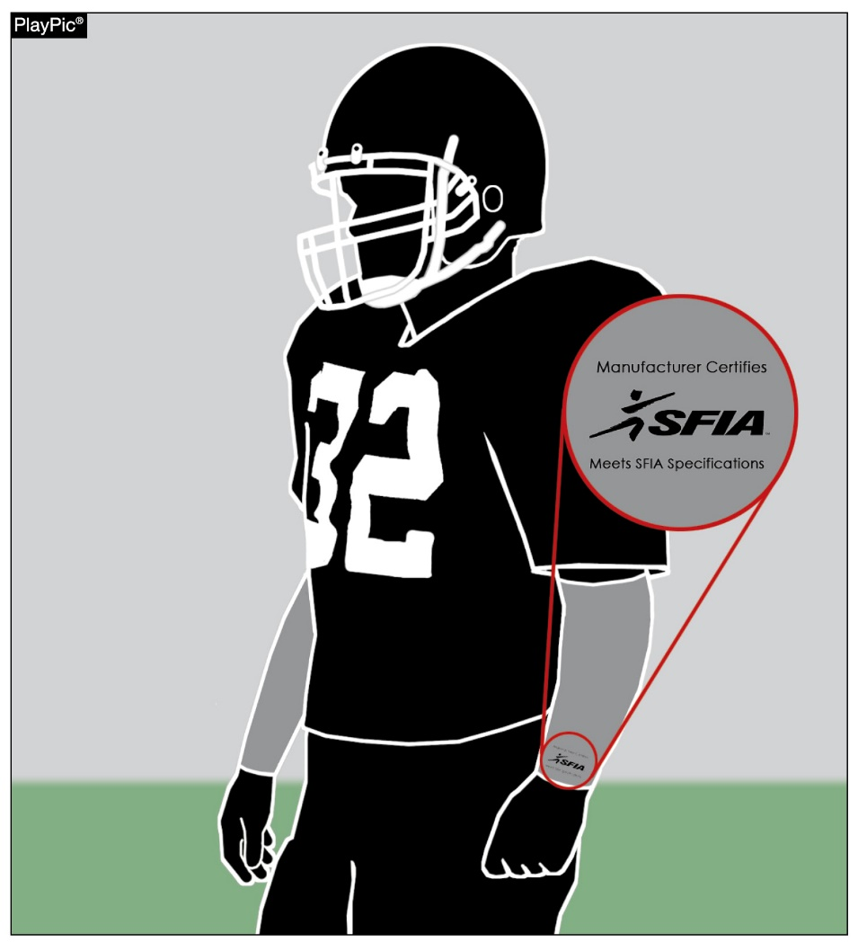
ARM SLEEVES
RULES 1-5-2d (NEW), 1-5-3c(6)
Effective 2027: Arm sleeves must have a permanent, exact replica of the SFIA arm sleeve seal (meets SFIA Specification), that must be visible and appear legibly on the exterior of the arm sleeve.
Notes:
RULES CHANGES:
See comments on slide

Slide 16
ELECTRONIC SIGNS
Notes:
Comment on Slide:
This statement appears at the bottom of page three in the 2025 NFHS Football Rules Book.

Slide 17
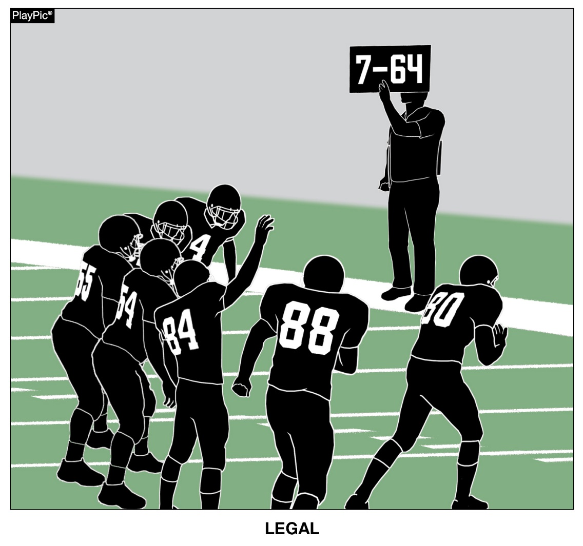
ELECTRONIC SIGNS
RULE 1-5-3c(2)
Fixed electronic signs (non-audio) with play signals are allowed to communicate from the sideline.
Notes:
Rules Changes:
RULE 1 – SECTION 5 PLAYER EQUIPMENT
ART. 3 . . . Illegal equipment. No player shall participate while wearing illegal equipment. This applies to any equipment, which in the opinion of the umpire is dangerous, confusing or inappropriate. Illegal equipment shall always include but is not limited to: …
c. The following Other Illegal Equipment: …
2. Except during an outside 9-yard mark conference (7-yard marks in nine-, eight- and six-player competition), electronic audio or non-fixed video communication devices used to communicate with a player. …
Rationale for Change: This change allows for the use of some additional equipment, but continues to preclude in-helmet communication. This would allow for fixed electronic signs with play signals as well as non-audio methods but still would not permit the players between the numbers to watch video.
Case Book: See SITUATION 1.6.1F

Slide 18
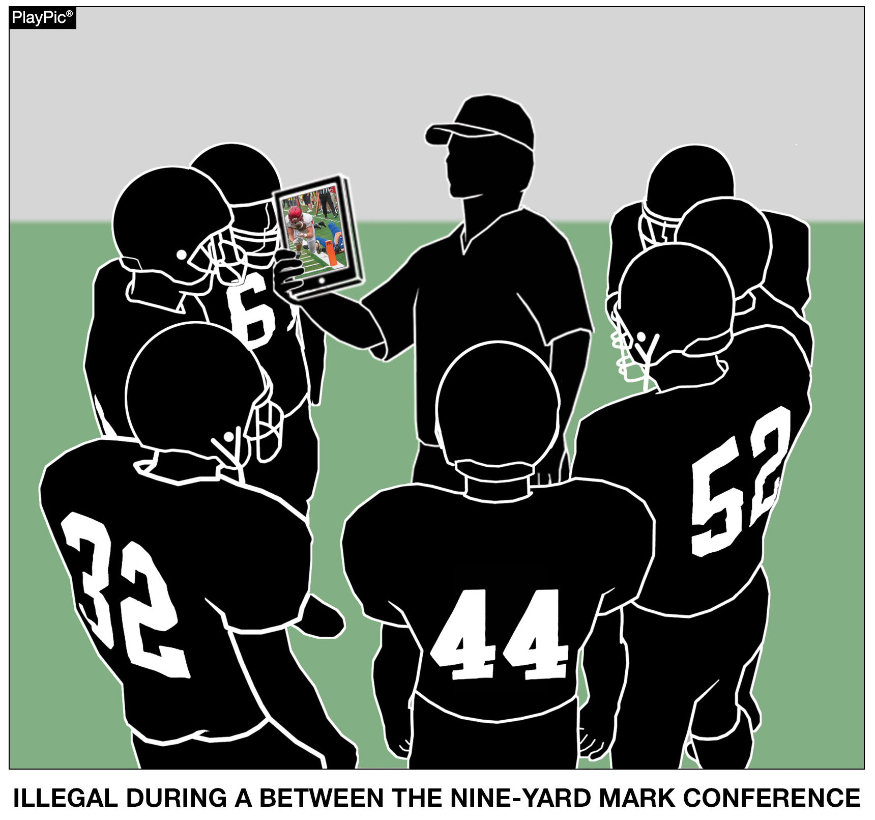
ELECTRONIC SIGNS
RULE 1-5-3c(2)
Scrolling graphics, video footage, connected audio communication are all examples of the use of illegal equipment if this were a between the nine-yard mark conference.
Notes:
RULES CHANGES:
See comments on slide

Slide 19
FORWARD FUMBLE
Notes:
Comment on Slide:
This statement appears at the bottom of page three in the 2025 NFHS Football Rules Book.

Slide 20
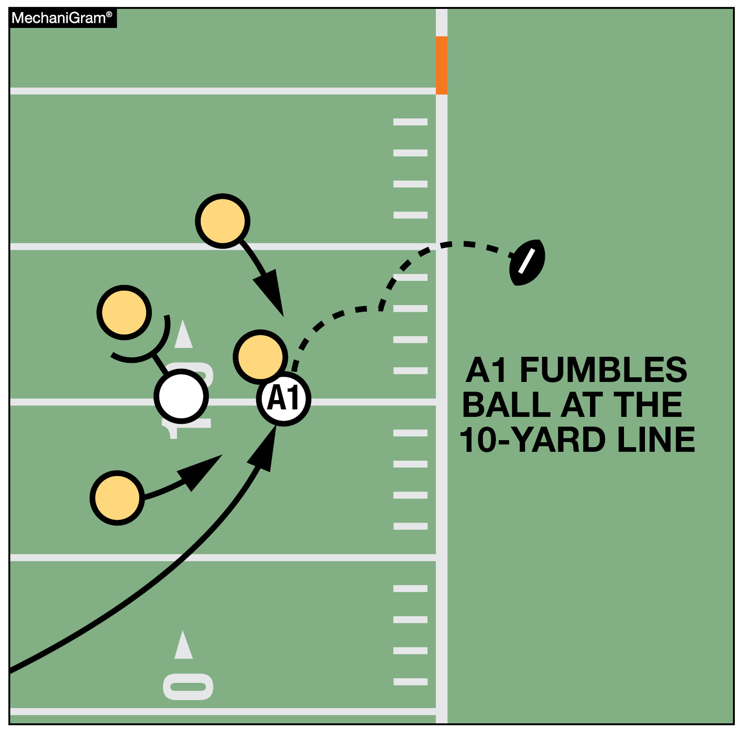
FORWARD FUMBLE
RULES 3-4-2d, 3-4-3a, 4-3-1 EXCEPTION (NEW)
When a forward fumble in the field of play goes out of bounds between the goal lines, the ball shall be returned to the spot of the fumble and the game clock is started on the ready-for-play.
The play clock is a 40-second clock.
The referee will give a silent wind to re-start the game clock.
Notes:
Rules Changes:
RULE 3 – SECTION 4 STARTING AND STOPPING THE CLOCK
ART. 2 . . . The game clock shall start with the ready-for-play on a down beginning with a snap if the game clock was stopped for any reason other than specified in Rule 3-4-3 or an untimed down: …
d. Team A forward fumble out of bounds.
ART. 3 . . . The game clock shall start with the snap or when any free kick is touched, other than first touching by K, if the game clock was stopped because:
a. The ball goes out of bounds, unless 4-3-1 EXCEPTION for forward fumble applies. …
RULE 4 – SECTION 3 OUT-OF-BOUNDS AND INBOUNDS SPOTS
ART. 1 . . . When a loose ball goes out of bounds, the out-of-bounds spot is fixed by the yard line where the foremost point of the ball crossed the sideline. When the ball becomes dead in the field of play because of touching a person who is out of bounds, the out-of-bounds spot is fixed by the yard line through the foremost point of the ball.
EXCEPTION: When a forward fumble goes out of bounds or is ruled out of bounds between the goal lines, the ball shall be returned to the spot of the fumble.
Rationale for Change: A situation potentially giving an unfair advantage to a fumbling team was revised. When a forward fumble goes out of bounds or is ruled out of bounds between the goal lines, the ball shall be returned to the spot of the fumble.
Case Book: See SITUATIONS 4.3.1A, 4.3.1B, 4.3.1C, 4.3.1D, 4.3.1E, 10.3.3C

Slide 21
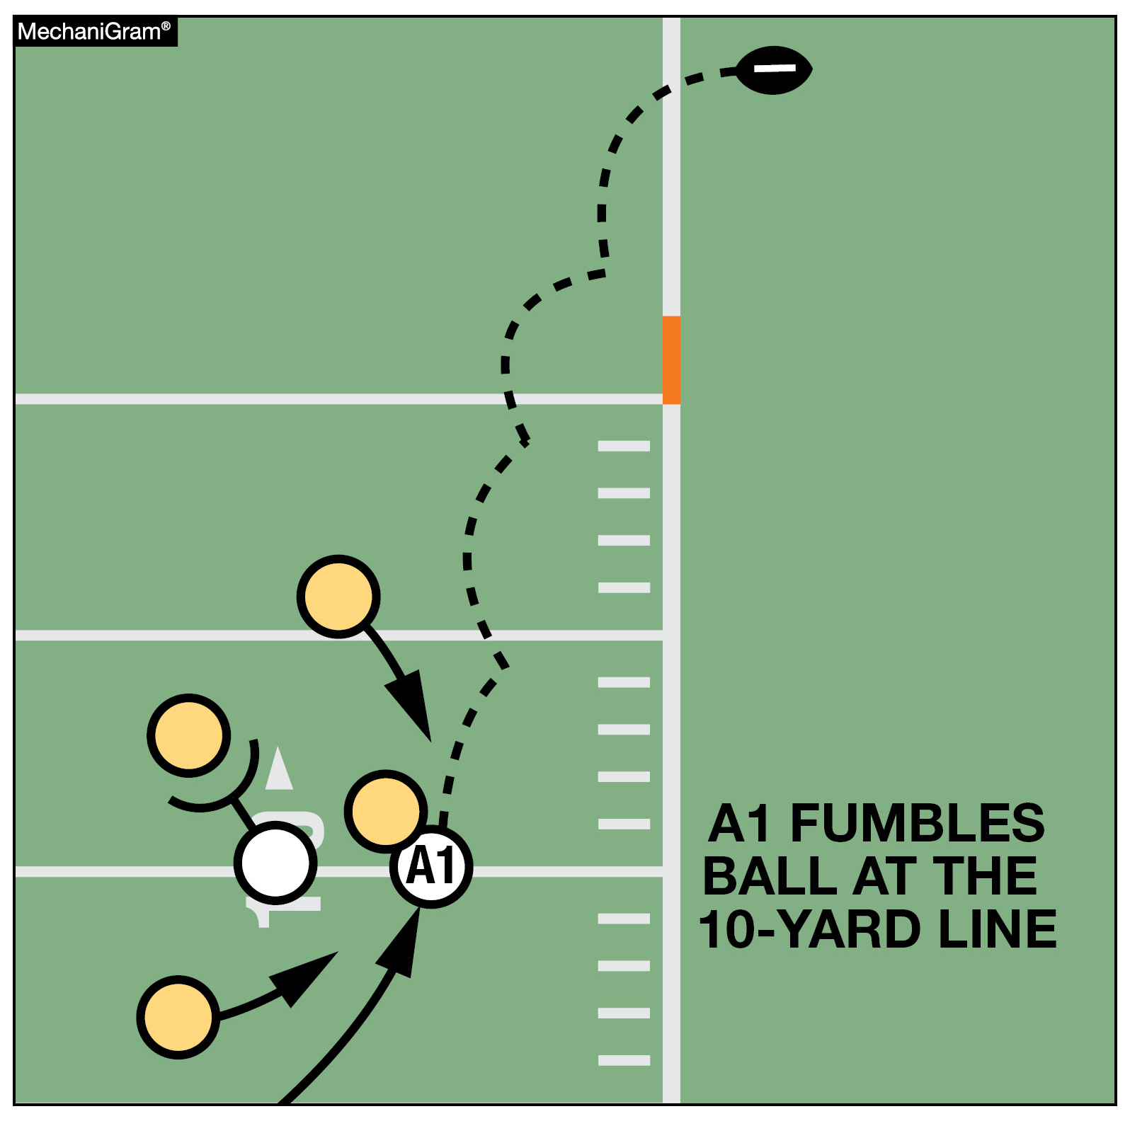
FORWARD FUMBLE
RULE 4-3-1 EXCEPTION (NEW)
When a forward fumble in the field of play goes into team B’s end zone and is ruled out of bounds, the ball is not returned to the spot of the fumble because it did not go out of bounds between the goal lines.
This play continues to result in a touchback.
Notes:
RULES CHANGES:
See comments on slide

Slide 22
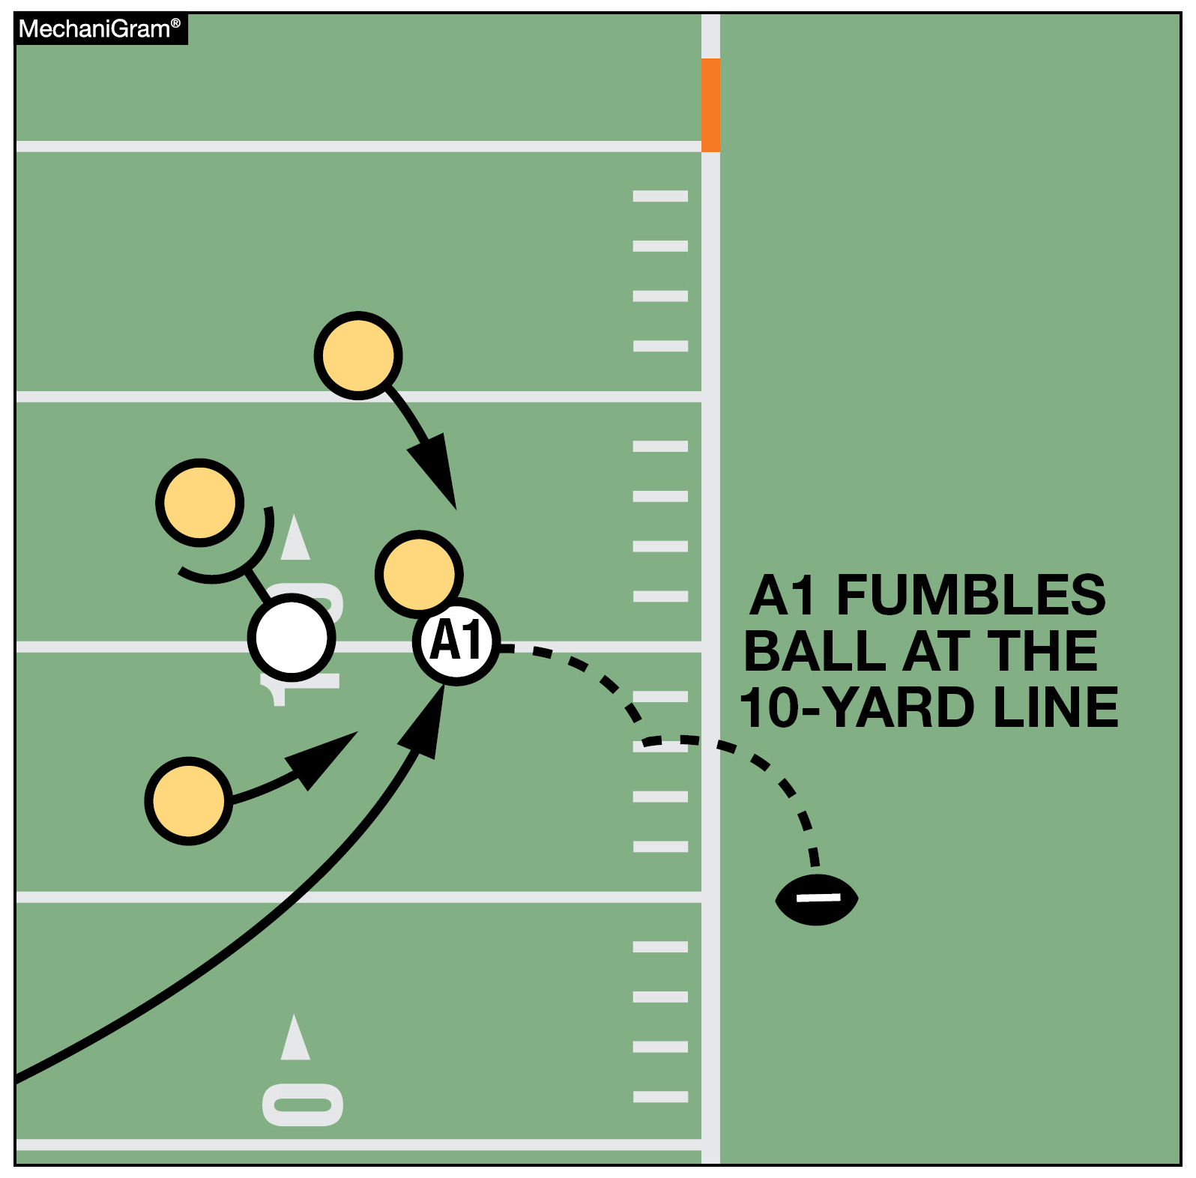
FORWARD FUMBLE
RULES 3-4-3a, 4-3-1 EXCEPTION (NEW)
When a backward fumble in the field of play goes out of bounds between the goal lines, the ball shall be spotted where it is ruled out of bounds and the game clock is started on the snap.
The play clock is a 40-second clock.
Notes:
RULES CHANGES:
See comments on slide

Slide 23
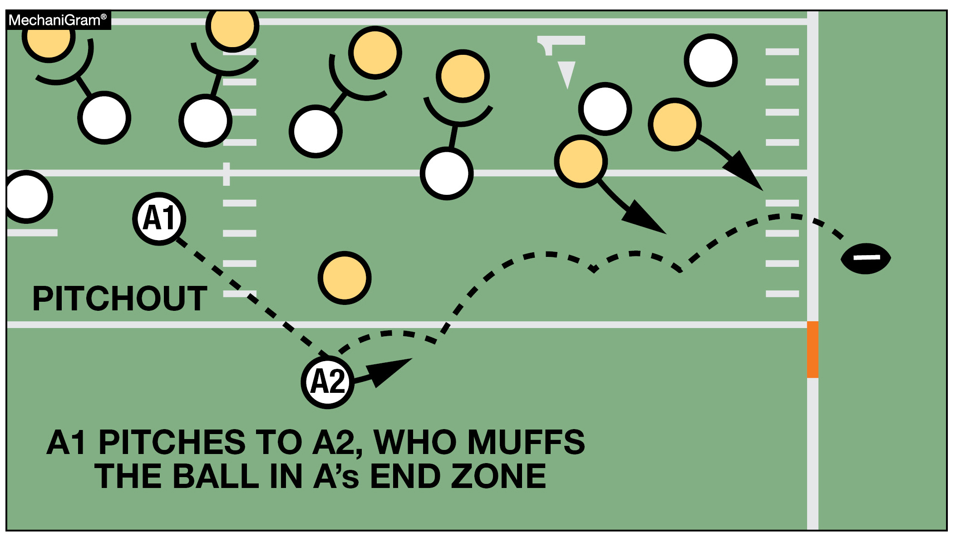
FORWARD FUMBLE
RULES 3-4-3a, 4-3-1 EXCEPTION (NEW)
A muff going forward does NOT qualify for the EXCEPTION and would be placed at the out of bounds spot and the clock started on the snap.
Notes:
RULES CHANGES:
See comments on slide

Slide 24
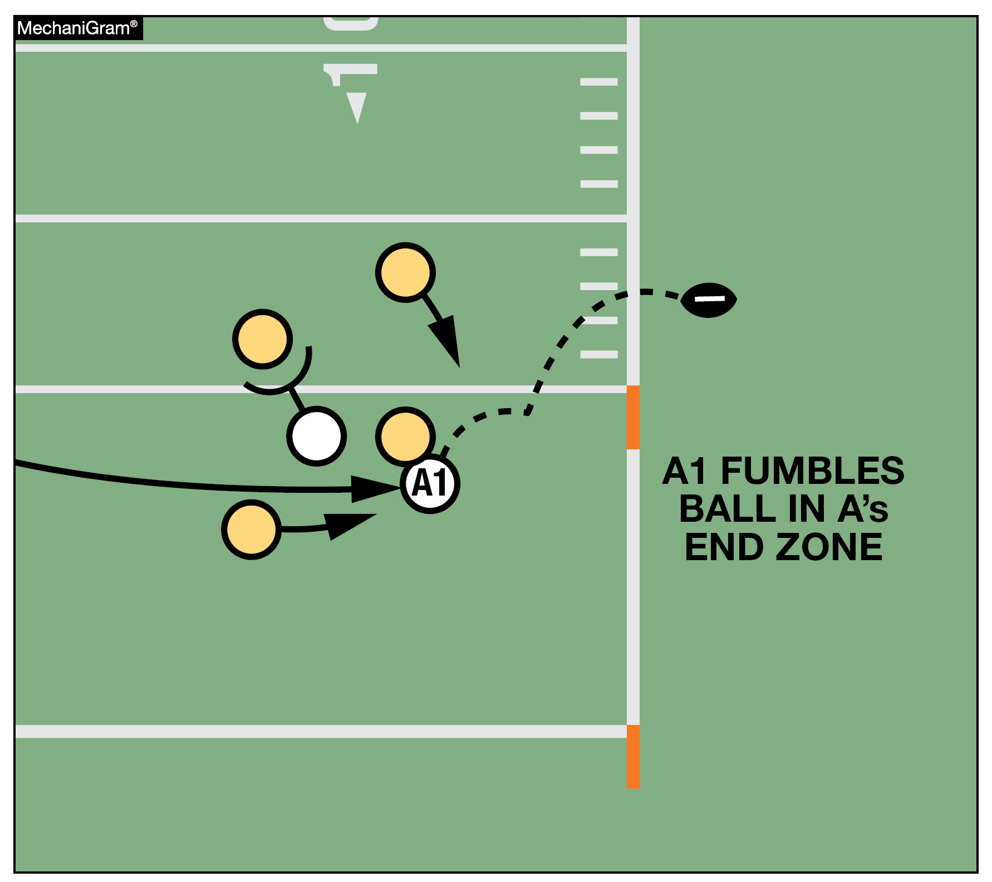
FORWARD FUMBLE
RULES 4-3-1 EXCEPTION (NEW), 8-5-2a EXCEPTION
When a forward fumble by team A from team A’s end zone goes out of bounds between the goal lines, the end of the run is in the end zone and the result of the play depends on who caused the ball to be in the end zone. If the momentum exception applies, the forward fumble exception would not apply and a safety would not be awarded.
Notes:
Rules Changes:
RULE 4 – SECTION 3 OUT-OF-BOUNDS AND INBOUNDS SPOTS
ART. 1 . . . When a loose ball goes out of bounds, the out-of-bounds spot is fixed by the yard line where the foremost point of the ball crossed the sideline. When the ball becomes dead in the field of play because of touching a person who is out of bounds, the out-of-bounds spot is fixed by the yard line through the foremost point of the ball.
EXCEPTION: When a forward fumble goes out of bounds or is ruled out of bounds between the goal lines, the ball shall be returned to the spot of the fumble.
RULE 8 – SECTION 5 FORCE, SAFETY AND TOUCHBACK
ART. 2 . . . It is a safety when:
a. A runner carries the ball from the field of play to or across his own goal line, and it becomes dead there in his team's possession.
EXCEPTION: When a defensive player intercepts an opponent's forward pass; intercepts or recovers an opponent's fumble or backward pass; or an R player catches or recovers a scrimmage kick or free kick between his 5-yard line and the goal line, and his original momentum carries him into the end zone where the ball remains in the end zone and is declared dead in the end zone in his team's possession or it goes out of bounds in the end zone, the ball belongs to the team in possession at the spot where the pass or fumble was intercepted or recovered or the kick was caught or recovered. This includes a fumble that goes from the end zone into the field of play and out of bounds. (4-3-1 EXCEPTION)
Rationale for Change: A situation potentially giving an unfair advantage to a fumbling team was revised. When a forward fumble goes out of bounds or is ruled out of bounds between the goal lines, the ball shall be returned to the spot of the fumble.
Case Book: See SITUATIONS 4.3.1A, 4.3.1B, 4.3.1C, 4.3.1D, 4.3.1E, 10.3.3C

Slide 25
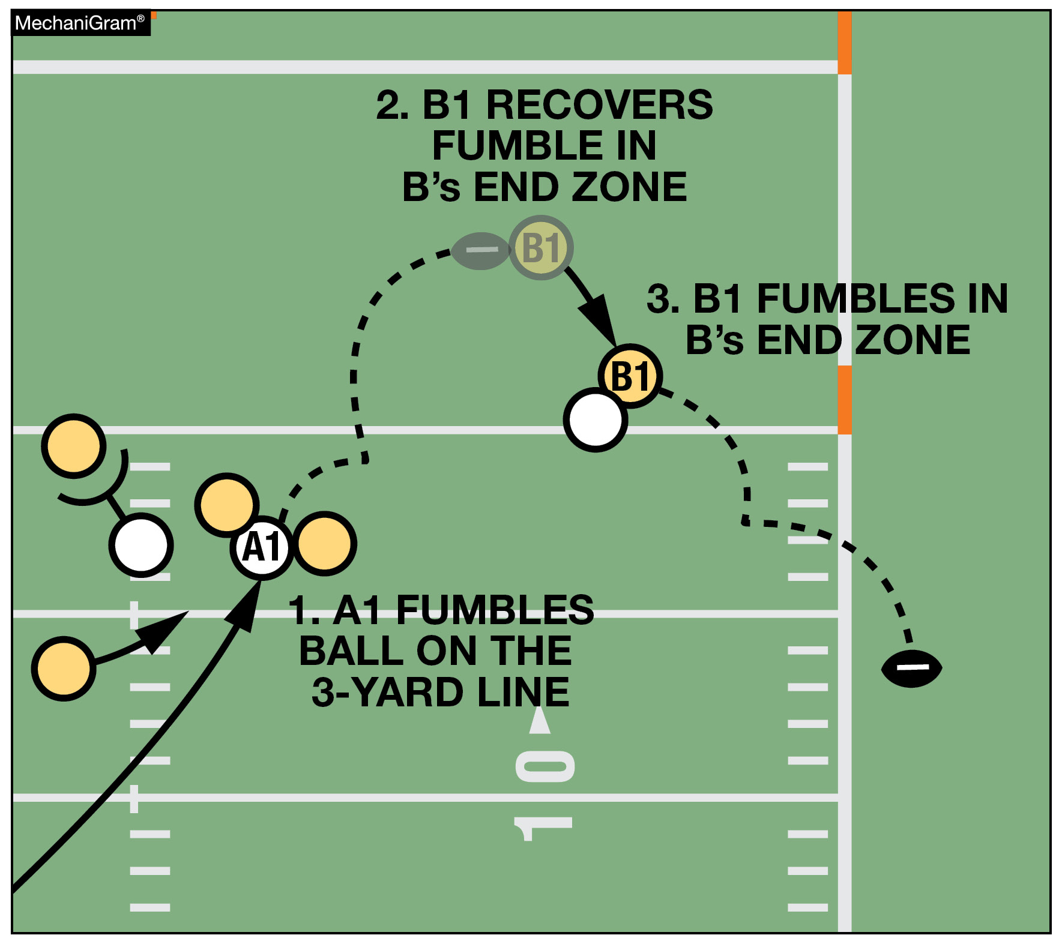
FORWARD FUMBLE
RULES 4-3-1 EXCEPTION (NEW), 8-5-2a EXCEPTION
When a forward fumble by team B from team B’s end zone goes out of bounds between the goal lines following a change of possession, the end of the related run is where possession was lost by B and the result of the play depends on who caused the ball to be in the end zone.
If the momentum exception applies, the forward fumble exception would not apply and a safety would not be awarded.
Notes:
RULES CHANGES:
See comments on slide

Slide 26
FORWARD FUMBLE
1) Did the runner fumble the ball? (Yes - Bean Bag at Spot of the Fumble)
2) Did the ball go out bounds between the goal lines before possession was regained?
3) Is the spot of #2 closer to the opponent's goal line than the spot of #1?
If the answer to all three is "yes", then you return the ball to the spot of the fumble. If any are "no", then don't do anything new and treat it like you did last year.
How the ball gets from the spot of the fumble to the spot where it goes out of bounds is irrelevant.
Notes:
Comment on Slide:

Slide 27
CASE PLAY
A's ball 1st and 10 at the A 30-yardline.
A11 runs to the left outside the hash mark and fumbles the ball forward at the A 25-yard line. In an attempt to recover the ball, B56 muffs the ball at the A 28-yard line. The ball goes OOB at:
1. A’s 35-yard line.
Stop the game clock when the ball goes OOB. 40-second play clock. The ball goes back to the A 25-yard line on the left hash. Start the game clock with a silent wind.
2. A’s 20-yard line.
Stop the game clock when the ball goes OOB. 40-second play clock. The ball is spotted at the A 20-yard line on the left hash. Game clock will start on the snap.
Notes:
Comment on Slide:

Slide 28
CASE PLAY
K's ball 4th and 10 at the K 30-yardline.
K11 is the punter in scrimmage kick formation. K11 possesses the snap and then drops the ball at the K 21-yard line. While the ball is on the ground, K11 illegally kicks the loose ball at the K 25-yard line. The ball goes OOB at the R 45-yard line.
Stop the game clock when the ball goes OOB. R declines the penalty. The ball goes back to the K 21-yard line.
1st and 10 for R at the K 21-yard line. 25-second play clock. Game clock starts on the snap.
Notes:
Comment on Slide:

Slide 29
Illegal Participation Penalty
Notes:
Comment on Slide:
This statement appears at the bottom of page three in the 2025 NFHS Football Rules Book.

Slide 30
Illegal Participation Penalty Enforcement Revised
RULES 9-6 PENALTY, 10-4-4b (DELETED)
Revisions to 9-6 PENALTY and the elimination of 10-4-4b have clarified and standardized penalty enforcement, specifically with regards to illegal participation fouls.
The penalty for all illegal participation fouls has been standardized as “15 yards, live ball, basic spot” enforcement.
This rule change does not allow a team to gain an advantage by entering and participating during a play.
Notes:
RULES CHANGES:
See comments on slide

Slide 31
2025 FOOTBALL EQUIPMENT ITEMS

Slide 32
ILLEGAL EQUIPMENT
Notes:
Comment on Slide:
This statement appears at the bottom of page three in the 2025 NFHS Football Rules Book.

Slide 33
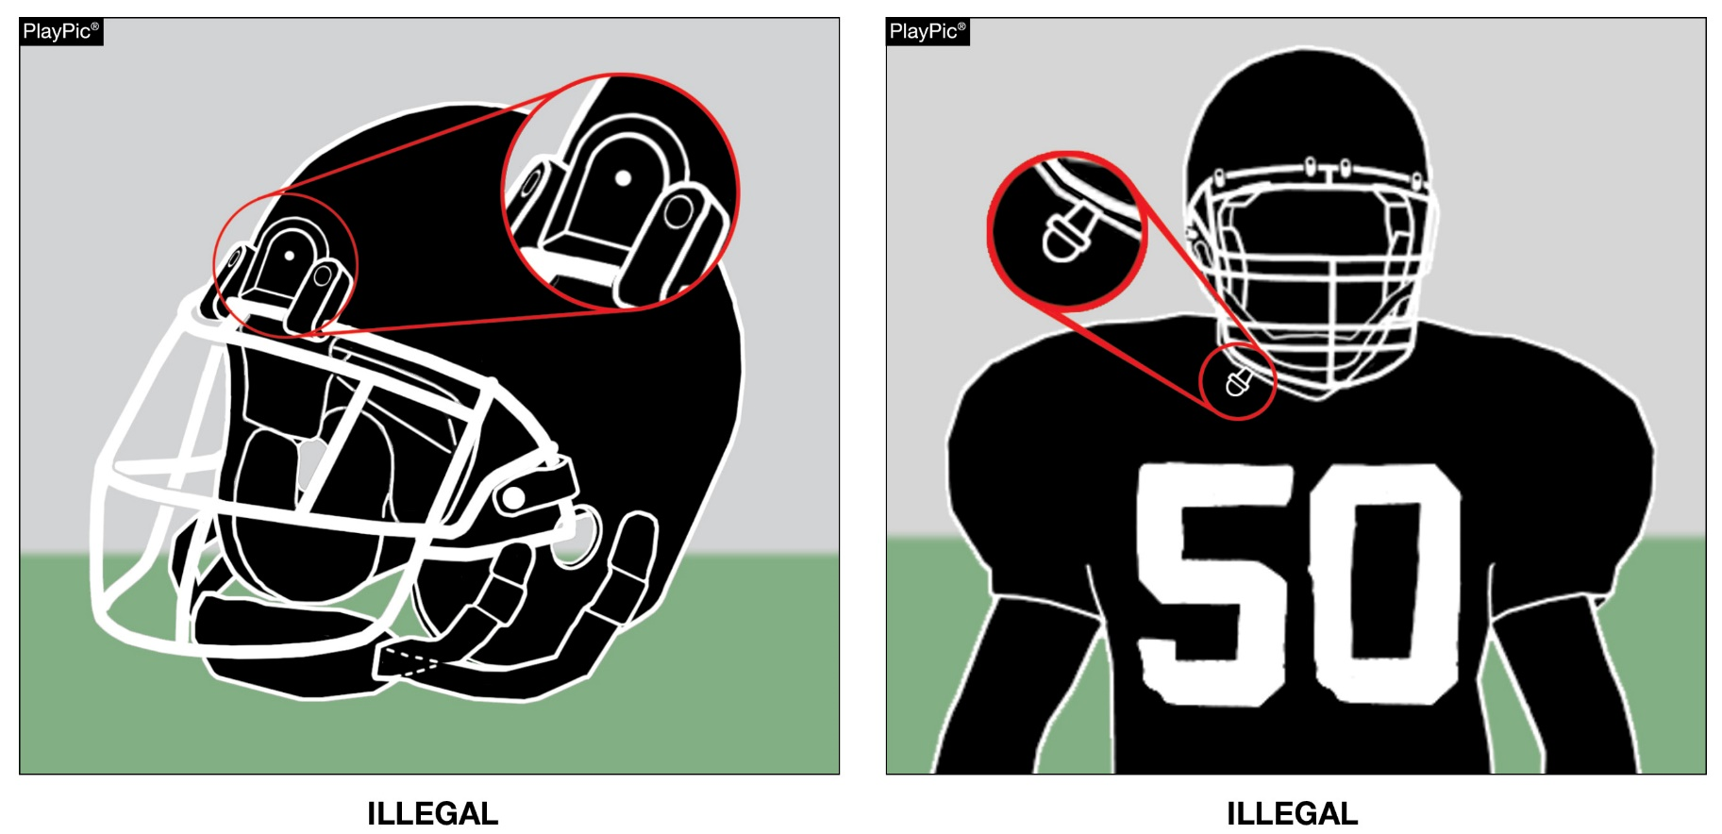
ILLEGAL EQUIPMENT
RULE 1-5-3c(3) (NEW)
Any video (camera) device or audio (microphone) worn by a player during the game is illegal.
Notes:
Rules Changes:
RULE 1 – SECTION 5 PLAYER EQUIPMENT
ART. 3 . . . Illegal equipment. No player shall participate while wearing illegal equipment. This applies to any equipment, which in the opinion of the umpire is dangerous, confusing or inappropriate. Illegal equipment shall always include but is not limited to: …
c. The following Other Illegal Equipment: …
3. Any audio (microphone) or video (camera) device worn by a player during the game. …
Rationale for Change: No player participating in the game will be allowed to wear any type of audio or video device in order to record or transmit audio or video.
Case Book: See SITUATION 1.6.1B

Slide 34
UNIFORMS
Notes:
Comment on Slide:
This statement appears at the bottom of page three in the 2025 NFHS Football Rules Book.

Slide 35
REQUIRED EQUIPMENT - RULE 1-5-1b
JERSEY
  If a school has any question or doubt about the legality of their football uniforms, the school should apply for a waiver from Todd Nelson at NYSPHSAA.
Notes:
RULES CHANGES:
See comments on slide

Slide 36
KNEE PADS
Notes:
Comment on Slide:
This statement appears at the bottom of page three in the 2025 NFHS Football Rules Book.

Slide 37
REQUIRED EQUIPMENT - RULE 1-5-1e
In collaboration with the NYS Football Committee and NYSPHSAA, the following is the procedure for enforcing
NFHS rule 1-5-1e; Pants which completely cover the knees, ….
The following are effective:
Short Pants – Too small to cover the Knees – (i.e., “Biker Shorts”)
  Players with pants that cannot cover the knees are not permitted to play.
  There are no warnings.
  During Pre-Game warmups if player(s) are identified as having pants that cannot be pulled down over the knees:
    Inform the Head Coach that the player(s) identified will not be permitted to play due to fact that they are not legally equipped.
    Inform the Head Coach that if the player(s) enter the field to play, the player(s) will be asked to return to the sidelines and an unsportsmanlike penalty will be assessed to the Head Coach for a player(s) wearing illegal equipment.
    Only 1 UNS will be assessed to the head coach per game, in the event that there are multiple players wearing illegal equipment.
Notes:
RULES CHANGES:
See comments on slide

Slide 38
REQUIRED EQUIPMENT - RULE 1-5-1e
In collaboration with the NYS Football Committee and NYSPHSAA, the following is the procedure for enforcing
NFHS rule 1-5-1e; Pants which completely cover the knees, ….
The following are effective:
Legal Pants that are tucked up above the knees
  Player(s) that tuck their pants up above their knees will not be permitted to play.
  Inform players entering the game that they need to return to the sidelines and pull their pants down to cover their knees.
  Repeated offenses by the same player(s) will result in an unsportsmanlike penalty being assessed to the Head Coach for player(s) wearing illegal equipment.
  Only 1 UNS will be assessed to the head coach per game, in the event that there are multiple occurrences.
Notes:
RULES CHANGES:
See comments on slide

Slide 39
REQUIRED EQUIPMENT - RULE 1-5-1e
Everyone must adhere to the above process, no exceptions.
Our collective objective (NYSPHSAA, NYS Football Committee, NYSACFO) is to eliminate the use of pants that don’t cover the knees whether they are too short or are tucked up above the knees. We need to do our part to achieve this objective and enforce the NFHS rule 1-5-1e.
Dr. Robert Zayas, NYSPHSAA Executive Director, notified all Section Executive Directors of the requirements above. Thus, all head coaches should be well aware of the process going forward.
As a reminder, one of our 2024 – 2025 objectives is consistency across all Chapters. Therefore, it is imperative that all Chapters follow the steps outlined above in a consistent manner to help eliminate the use of illegal equipment (short pants) from our game. No Exceptions!
Notes:
RULES CHANGES:
See comments on slide

Slide 40
ELECTRONIC EQUIPMENT
Notes:
Comment on Slide:
This statement appears at the bottom of page three in the 2025 NFHS Football Rules Book.

Slide 41
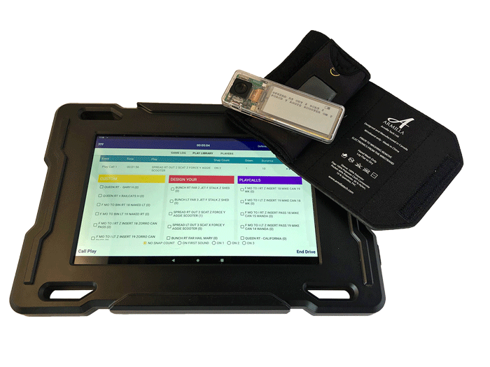
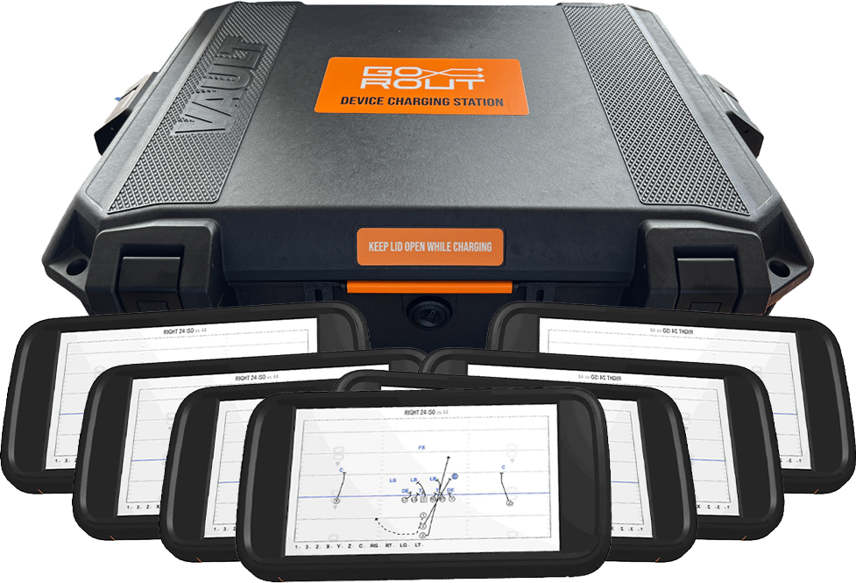
ILLEGAL COACH-TO-PLAYER TECHNOLOGY
RULES 1-5-3c(2), 1-6-1
GoRout
Armilla Tech
Notes:
RULES CHANGES:
See comments on slide

Slide 42
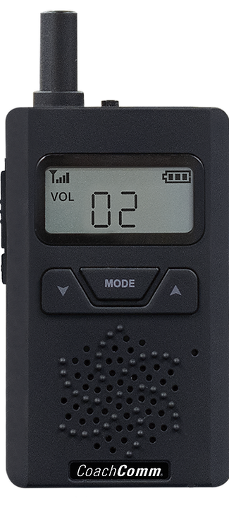

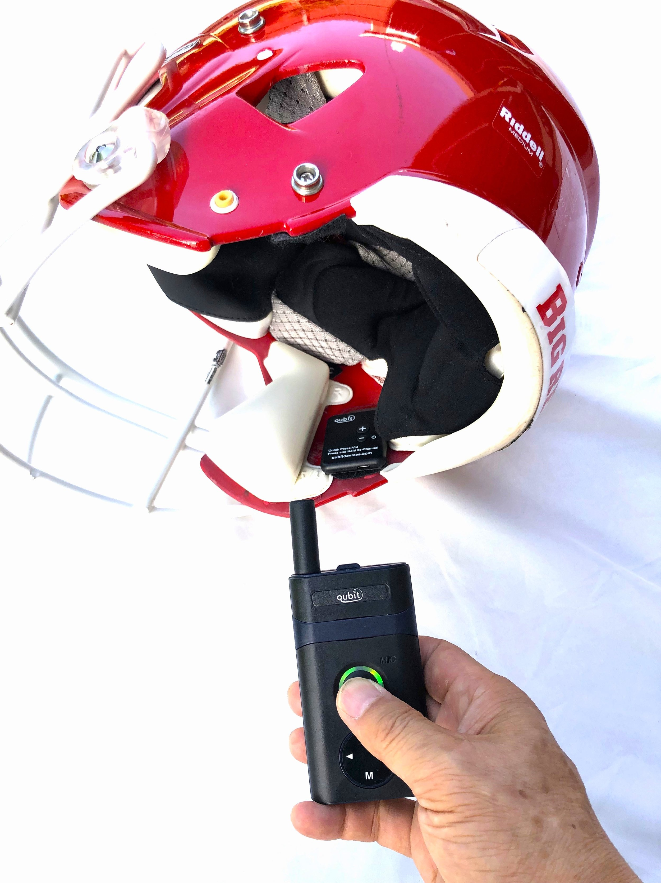
ILLEGAL COACH-TO-PLAYER TECHNOLOGY
RULES 1-5-3c(2), 1-6-1
Qubit
PROCOM
CoachComm
Notes:
RULES CHANGES:
See comments on slide

Slide 43
OTHER EQUIPMENT
Notes:
Comment on Slide:
This statement appears at the bottom of page three in the 2025 NFHS Football Rules Book.

Slide 44

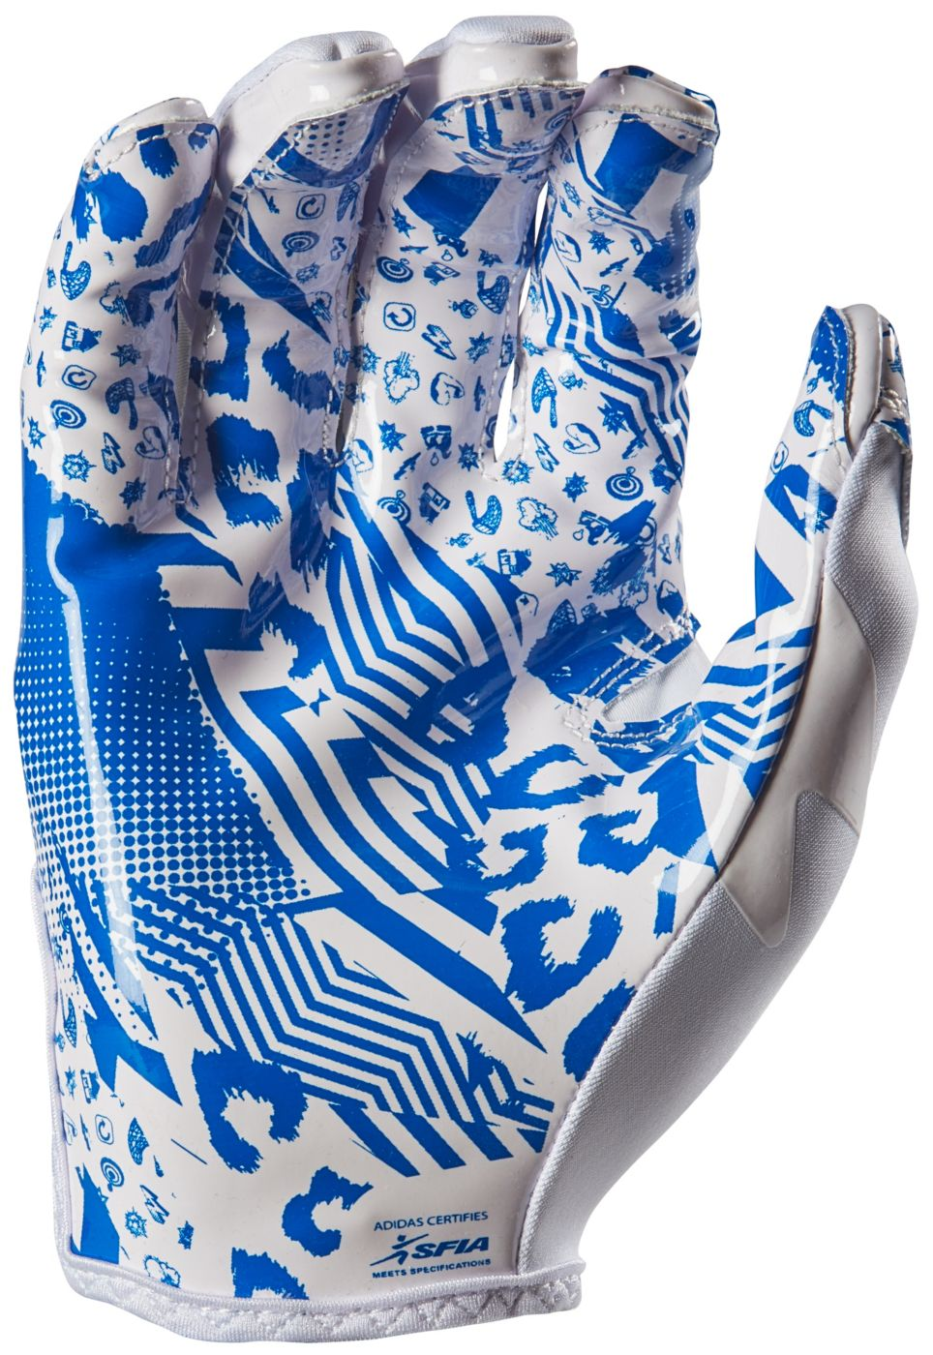
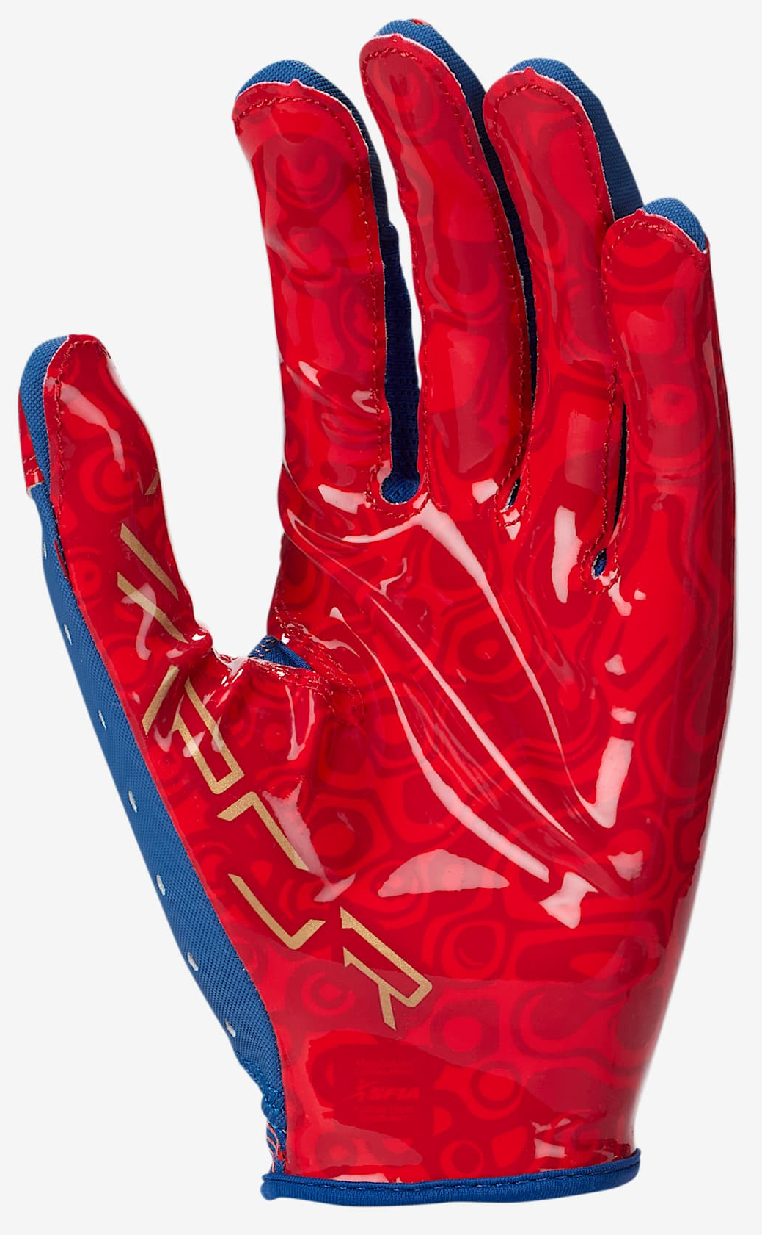
FOOTBALL GLOVES
Notes:
Comment on Slide:
See comments on the slide.

Slide 45
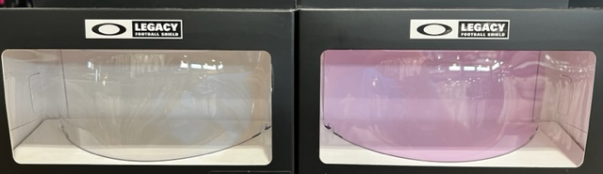
Oakley football visor (prizm clear)
LEGAL
ILLEGAL

Slide 46
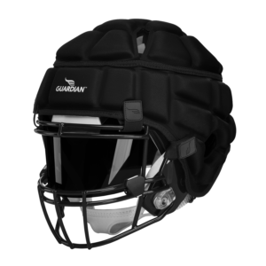
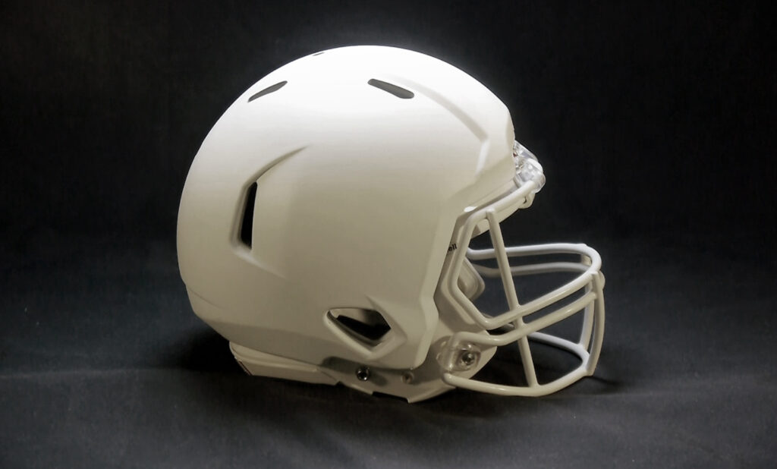
Football helmet covers
Permissible by 2025 current NFHS Football Rules
GUARDIAN CAPS
SAFR PRO TECH
Notes:
Comment on Slide:
See comments on the slide.

Slide 47
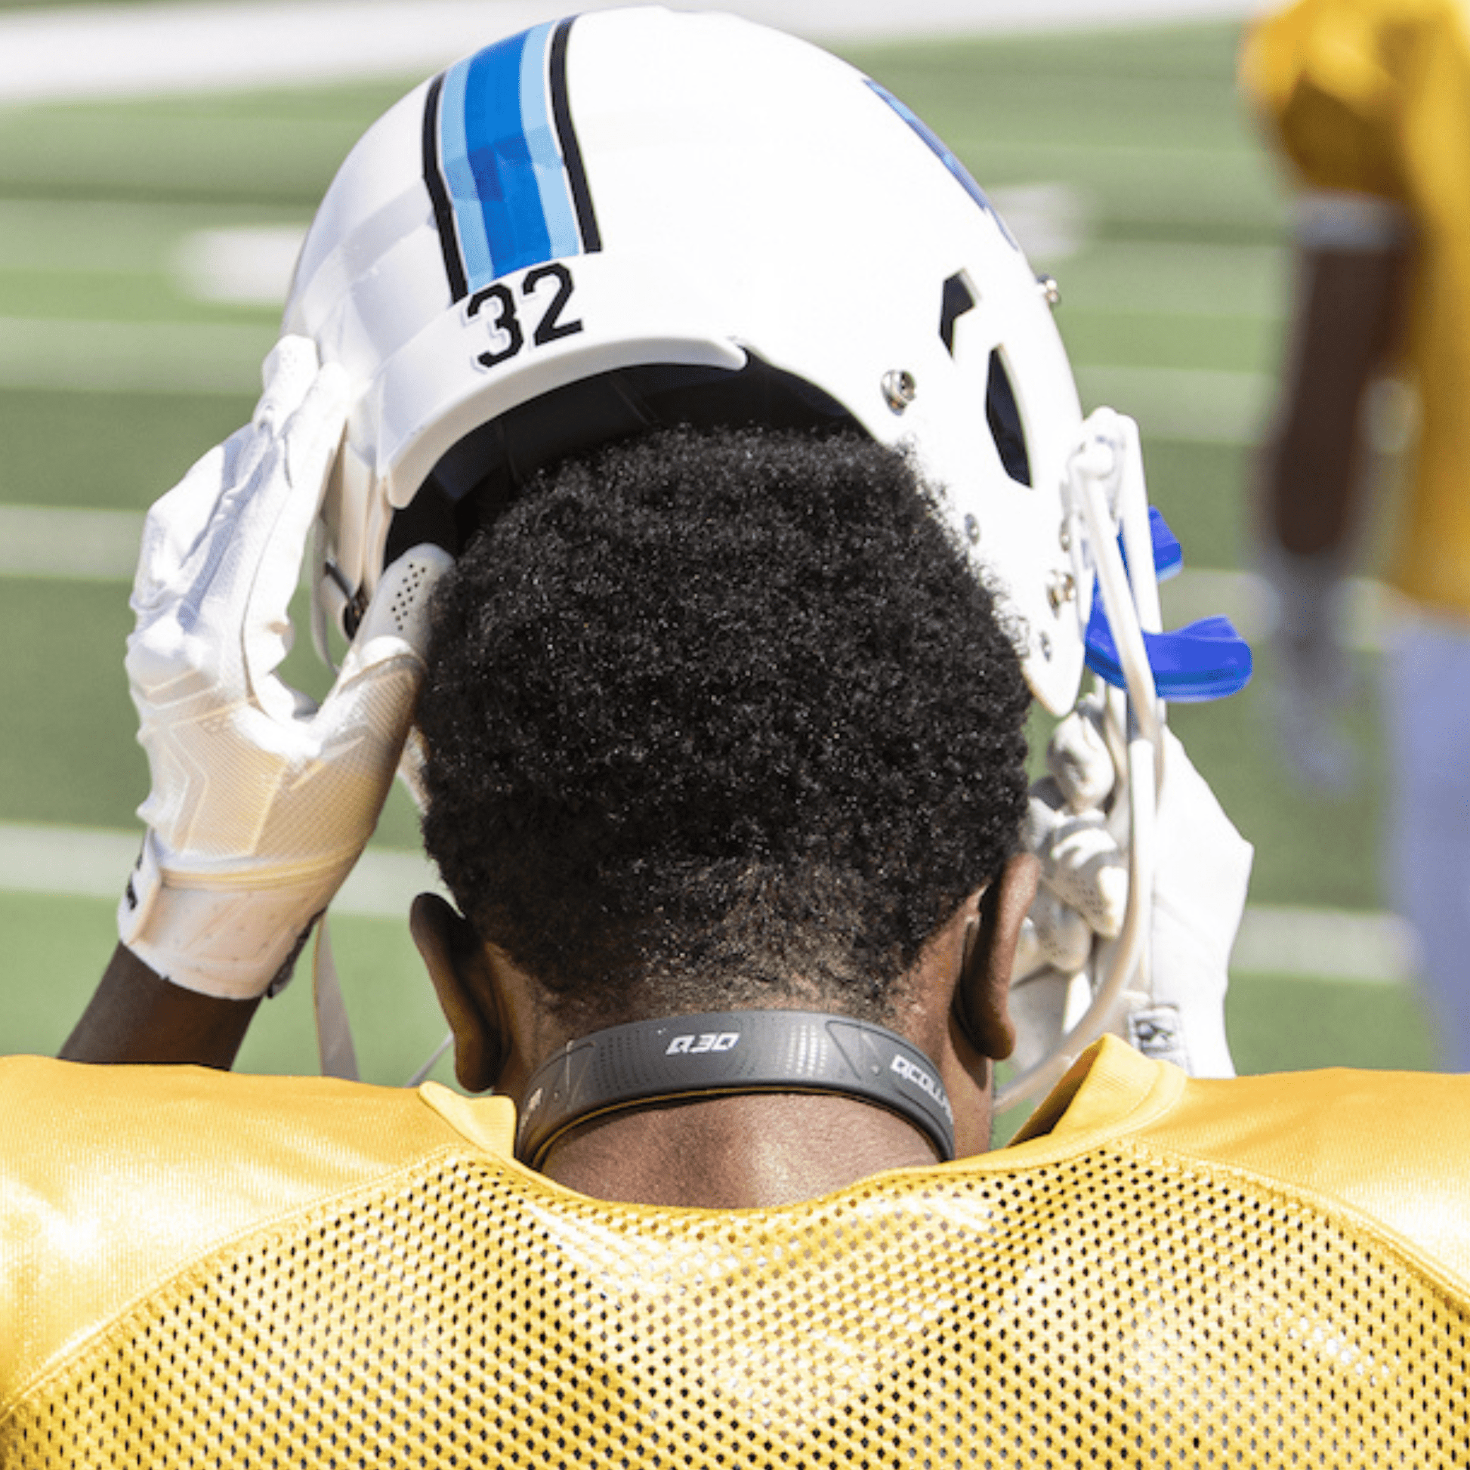
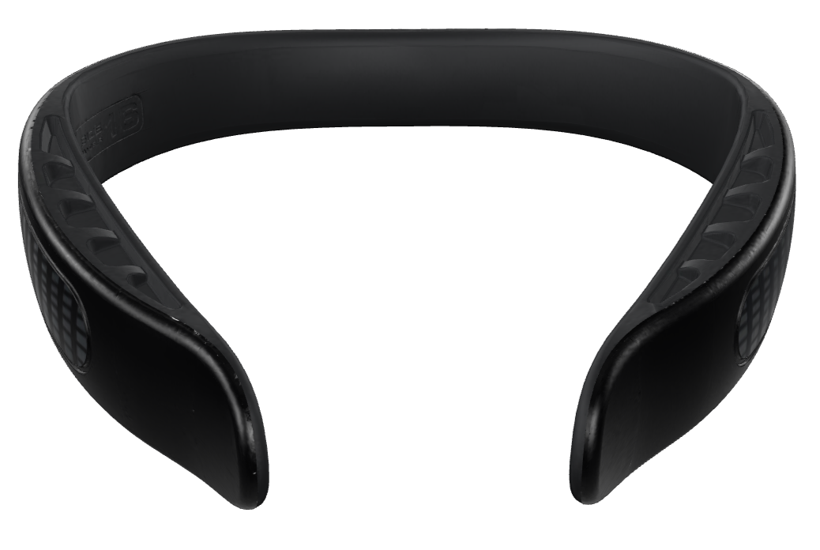
Q-COLLAR
Permissible by current 2025 NFHS Football Rules
Notes:
Comment on Slide:
See comments on the slide.

Slide 48
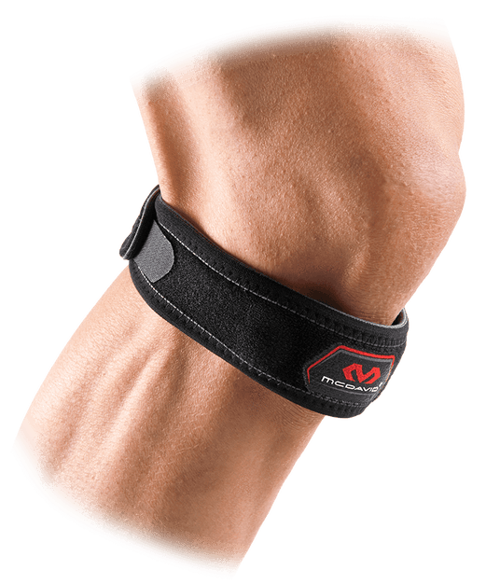
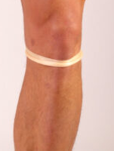
PATELLAR TENDON STRAPS
Patellar tendon straps are permissible by current 2025 NFHS Football Rules and is not considered an illegal equipment adornment.
Notes:
Comment on Slide:
See comments on the slide.

Slide 49
2025 NFHS FOOTBALL EDITORIAL CHANGES
Notes:
Robert

Slide 50
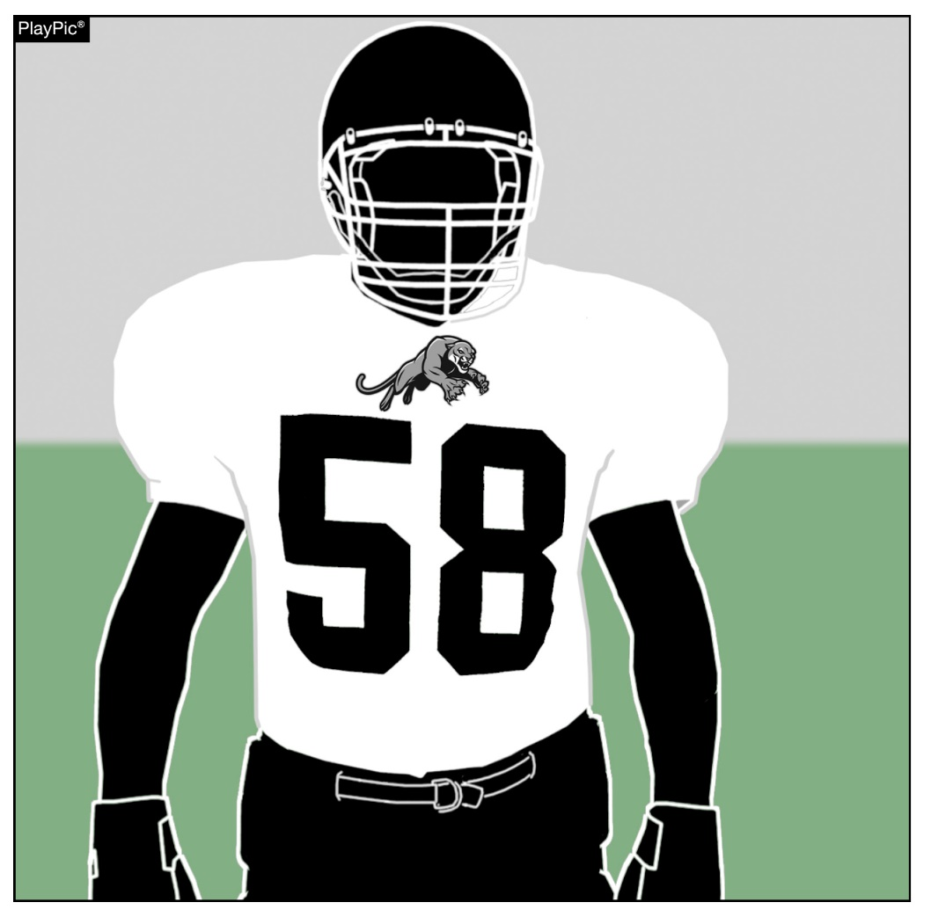
JERSEY MARKINGS
RULES 1-5-1b(2)b(1), 1-5-1b(3)b(1)
A school mascot is considered an allowable adornment to a jersey, in addition to the number, school’s nickname, school logo, school name and player name.
Notes:
EDITORIAL CHANGE:
RULE 1 – SECTION 5 PLAYER EQUIPMENT
ART. 1 . . . Mandatory equipment. Each player shall participate while wearing the following pieces of properly fitted equipment, which shall be professionally manufactured and not altered to decrease protection: …
Jersey: …
2. Players of the visiting team shall wear jerseys, unaltered from the manufacturer’s original design/production, that meet the following criteria: … (b) The body of the jersey shall contain only the listed allowable adornments and accessory patterns in a color(s) that contrasts to white:
(1) as the jersey number(s) required in 1-5-1c or as the school’s nickname, school logo, school mascot, school name and/or player name within the body and/or on the shoulders, …
3. Players of the home team shall wear jerseys, unaltered from the manufacturer’s original design/production, that meet the following criteria: … (b) The jerseys of the home team shall all be the same dark color(s) that clearly contrasts to white. If white appears in the body of the
jersey of the home team, it may only appear:
(1) as the jersey number(s) required in 1-5-1c or as the school’s nickname, school logo, school mascot, school name and/or player name within the body and/or on the shoulders, …
Rationale for Change: Further clarified what could be on a home or visitor jersey.

Slide 51
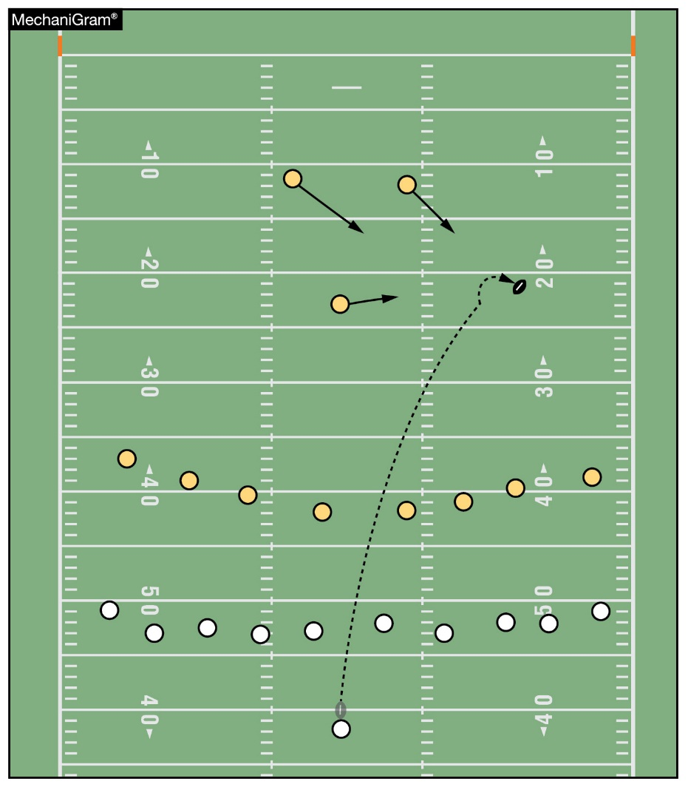
PENALTY ENFORCEMENT
RULE 2-33-1a
A loose-ball play is action during a free kick or scrimmage kick other than post-scrimmage kick fouls as defined in 2-16-2h.
Notes:
EDITORIAL CHANGE:
See comments on slide

Slide 52
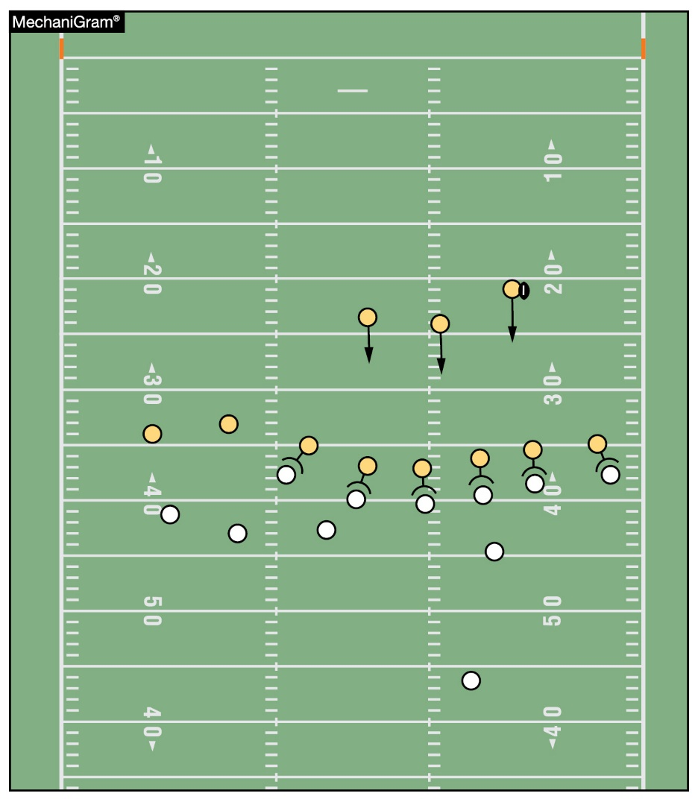
TYPES OF PLAYS
RULES 10-3-1, 2
A loose-ball play is action defined in 2-33-1a, b, c, and d. A running play is any action as defined in 2-33-2.
Notes:
EDITORIAL CHANGE:
See comments on slide

Slide 53
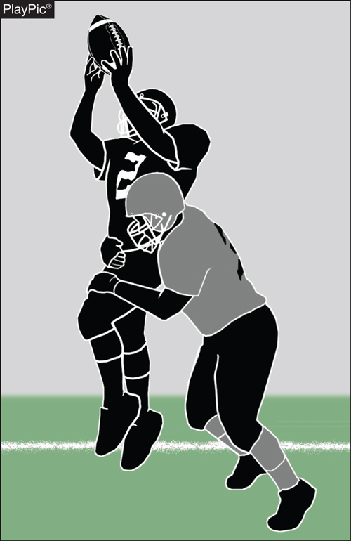
DEFENSELESS RECEIVER
RULE 9-4-3p (NEW)
ART. 3 . . . No player or nonplayer shall: …
p. Initiate forceful contact against a defenseless receiver as in 2-32-16b and 2-32-16c that is not:
1. Incidental contact as a result of making a play on the ball;
2. Initiated with open hands; or
3. An attempt to tackle by wrapping arm(s) around the receiver.
PENALTY: 15 Yards (Personal Foul)
Notes:
EDITORIAL CHANGE:
RULE 9 – SECTION 4 ILLEGAL PERSONAL CONTACT
ART. 3 . . . No player or nonplayer shall: …
p. Initiate forceful contact against a defenseless receiver as in 2-32-16b and 2-32-16c that is not:
1. Incidental contact as a result of making a play on the ball;
2. Initiated with open hands; or
3. An attempt to tackle by wrapping arm(s) around the receiver.
PENALTY: … Arts. 3a through g, l, p – Other personal fouls – (S38) – 15 yards; …
Rationale for Change: Rule 2-32-16d was eliminated and contact against a defenseless receiver has been reorganized into a new Rule 9-4-3p.

Slide 54
2025 NFHS FOOTBALL EDITORIAL CHANGES
2-32-16d | Removed 2-32-16d and placed it under a new 9-4-3p.
2-41-9b | Removed the term “related running play.”
2-41-9c, 10-3-3c | Added in reference to “8-5-2a EXCEPTION” to the rule.
6-1-9 | Simplified the existing rules language dealing with a free kick.
7-2-5b EXCEPTION 2 | Clarified the existing rule dealing with the snapper.
9-4 PENALTY | Added a new PENALTY for the new 9-4-3p dealing with a defenseless receiver.
9-5-1g, 9-8-1j | Changed “contest” to “game.”
9-8-1g | Clarified the existing rule dealing with the team.
Notes:
EDITORIAL CHANGES:
Comment on Slide:
This slide lists the rules references and a brief description of the additional football editorial changes that were made to the 2025 NFHS Football Rules Book.

Slide 55
2025 NFHS FOOTBALL EDITORIAL CHANGES
10-4-2b | Changed the penalty reference for special enforcement on roughing the passer to 9-4-4 PENALTY.
10-4-2d | Grammar changes within the rules language.
10-4-4a | Correct an omission when the rule was reorganized.
10-5-3 | Further clarified enforcement with regards to a safety.
9-, 8-, 6-Player Rules Differences | Updated rules references.
PENALTY SUMMARY | Added 9-4-3p to the list under loss of 15 yards.
INDEX | Updated the index with revised rules references.
Notes:
EDITORIAL CHANGES:
Comment on Slide:
This slide lists the rules references and a brief description of the additional football editorial changes that were made to the 2025 NFHS Football Rules Book.

Slide 56
2025 NFHS FOOTBALL RULES REMINDER
Notes:
Jessy

Slide 57
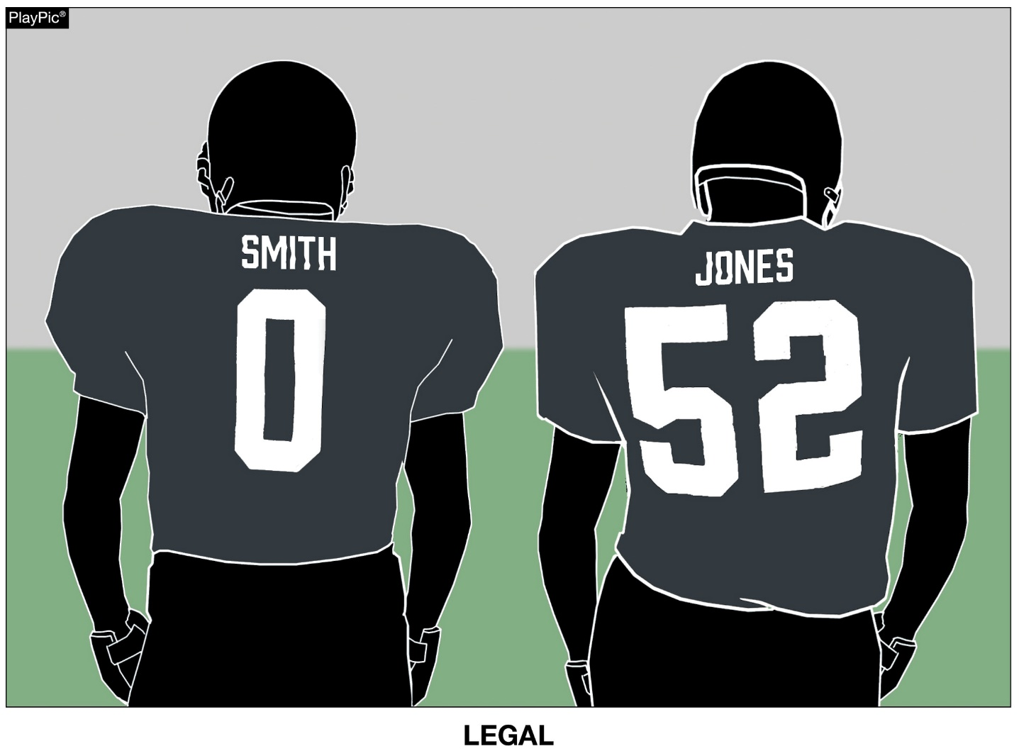
HOME JERSEYS
RULE 1-5-1b(3)
Jerseys of the home team shall all be the same dark color(s) that clearly contrasts to white.
KANE
FISH
Notes:
RuleS Reminder:
RULE 1 – SECTION 5 PLAYER EQUIPMENT
ART. 1 . . . Mandatory equipment. Each player shall participate while wearing the following pieces of properly fitted equipment, which shall be professionally manufactured and not altered to decrease protection: …
b. Jersey: …
3. Players of the home team shall wear jerseys, unaltered from the manufacturer’s original design/production, that meet the following criteria:
(a) The body of the jersey (inside the shoulders, inclusive of the yoke of the jersey or the shoulders, below the collar, and to the bottom of the jersey) may not include white, except as stated below.
(b) The jerseys of the home team shall all be the same dark color(s) that clearly contrasts to white. If white appears in the body of the jersey of the home team, it may only appear: …
Comment: Clarified home team uniform requirement for each player. The jerseys of the home team shall all be the same dark color(s) that clearly contrasts with white.
Case Book: See SITUATION 9.8.1H

Slide 58
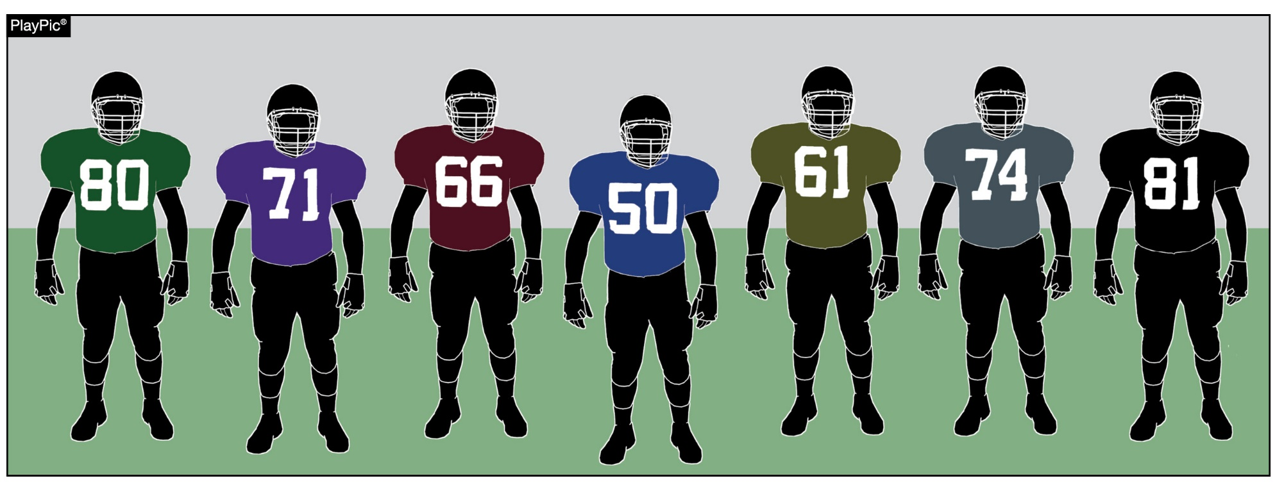
HOME JERSEYS
RULE 1-5-1b(3)
These jerseys of the home team are illegal because all members of the home team must wear the same dark color(s) that clearly contrasts to white.
Notes:
RuleS Reminder:
See comments on slide

Slide 59
2025 NFHS FOOTBALL POINTS OF EMPHASIS

Slide 60
2025 NFHS FOOTBALL POINTS OF EMPHASIS
1. Illegal and Improperly Worn Player Equipment
2. Sportsmanship
3. Defenseless Player / Targeting
Notes:
POINTS OF EMPHASIS:
Comment on Slide:
The following football points of emphasis were selected by the NFHS Football Rules Committee for the 2025 high school football season. These three football points of emphasis need to be stressed to all coaches, game officials, players, parents, school administrators, appropriate health-care professionals and all others who have an interest in high school football.

Slide 61
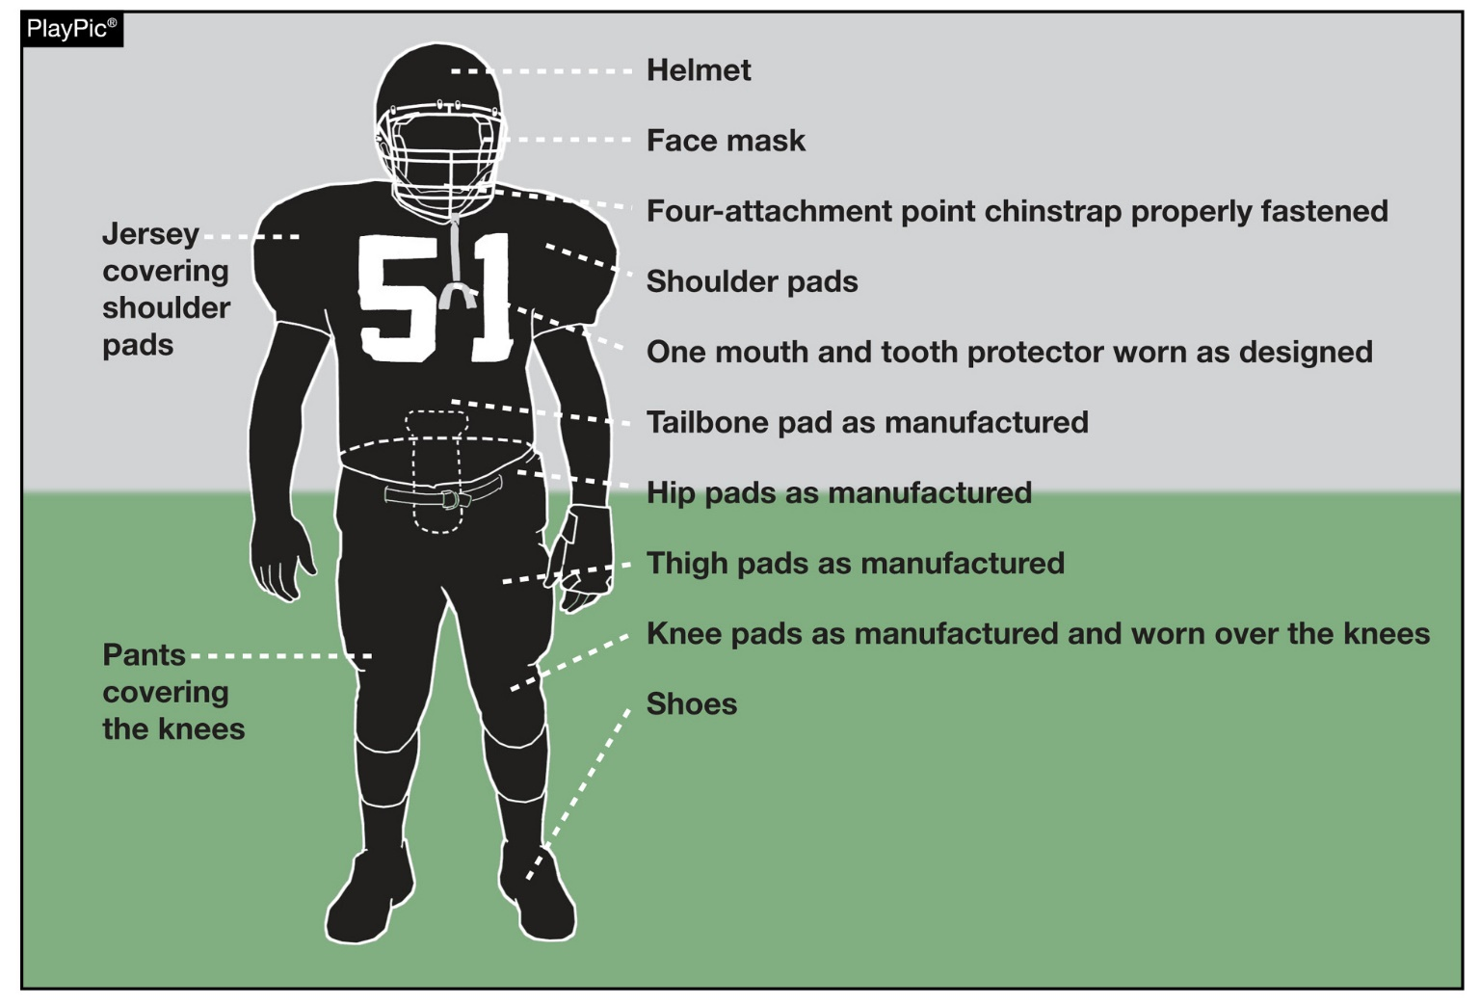
ILLEGAL AND IMPROPERLY WORN PLAYER EQUIPMENT
To support the safety of all participants, players must wear equipment and uniforms that are properly fitted and worn as intended by the manufacturer. Before starting each game, the head coach must verify that all players are properly and legally equipped. Allowing players to use illegal equipment or to wear required equipment improperly could subject the coach to a penalty.
Notes:
Illegal and Improperly Worn Player Equipment (Point of Emphasis):
In high school football, players must adhere to specific equipment standards for safety and fairness concerns. Illegal equipment refers to items that are prohibited such as: jewelry; tinted visors; non-compliant eye shade; bands worn around the upper arm, neck or legs; back pads not covered; and sweatbands and uniform adornments, including towels, that do not conform to the rules.
On the other hand, improperly worn equipment pertains to all equipment that is otherwise legal but not worn as intended. Examples include pants not covering the knees as required, tooth and mouth protectors not being worn as play starts, and shoulder pads not properly covered by the jersey. Incorrectly wearing these items can diminish their protective effectiveness and potentially endanger players.
Despite the lack of enforcement at the college level, the NFHS is proud of the work high school players, coaches, and game officials have done to properly enforce all rules that reduce the risk of injury. The rules and regulations governing high school football are designed to reduce the injury risk of players while maintaining the integrity and fairness of the game. These rules, often overlooked by casual spectators, play a crucial role in protecting the athletes and preserving the uniformity of team's appearance. Despite the negative influences by levels of play beyond high school, coaches and game officials must remain vigilant with enforcement of the equipment rules currently in place at the high school level.
Non-compliance with these rules can result in various penalties, ranging from removal of a player for one play for improperly worn equipment, to an unsportsmanlike penalty on the head coach when players are illegally equipped following the pre-game certification.
Chronic violations of the rule for properly worn equipment can significantly impact the game's fairness and safety. Repeated offenses not only jeopardize the individual player’s well-being but also negatively impact the pace of the game, and fairness to the opposing team.

Slide 62
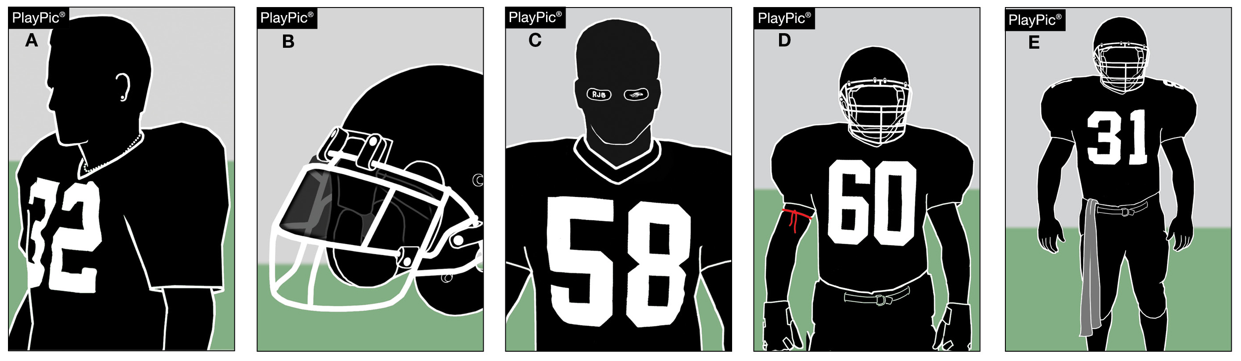
ILLEGAL AND IMPROPERLY WORN PLAYER EQUIPMENT
Illegal (prohibited) equipment includes jewelry (A), tinted visors (B), non-compliant eye shade (C), bands worn around the upper arm, neck or legs (D), and uniform adornments like towels that do not conform to rules (E).
Notes:
Illegal and Improperly Worn Player Equipment (Point of Emphasis) continued:
When players persistently disregard the equipment guidelines, there are several administrative options within current NFHS rules:
• A delay-of-game penalty would be a logical consequence for persistent offenses that significantly impact the pace of play.
• Chronic violations of equipment rules by players could result in an unsportsmanlike conduct foul being assessed under Rule 1-5-3c(10) and 9-8-1h, for equipment not worn as intended by the manufacturer.
• Finally, a coach who demonstrates a lack of interest in supporting these important rules of our sport could be easily judged to be acting in an unsportsmanlike manner.
Coaches play a pivotal role in addressing chronic violations of equipment rules. They must instill the importance of proper equipment use through consistent reinforcement and education. Additionally, fostering an environment where players hold each other accountable can help minimize infractions. Game officials must also remain vigilant and enforce penalties consistently to deter chronic violations. Issuing temporary removals from the game and escalating penalties for repeated offenses are necessary measures to uphold the integrity of the game.
The high school football player equipment rules are a testament to the sport's commitment to player safety and team unity. This unity extends beyond aesthetics; it reinforces the idea that each player is part of a larger whole, working together toward a common goal. A team’s integrity is maintained when no player stands out for the wrong reason. While it may seem like a minor detail, these regulations play a significant role in reducing injury and maintaining the integrity of the game.

Slide 63
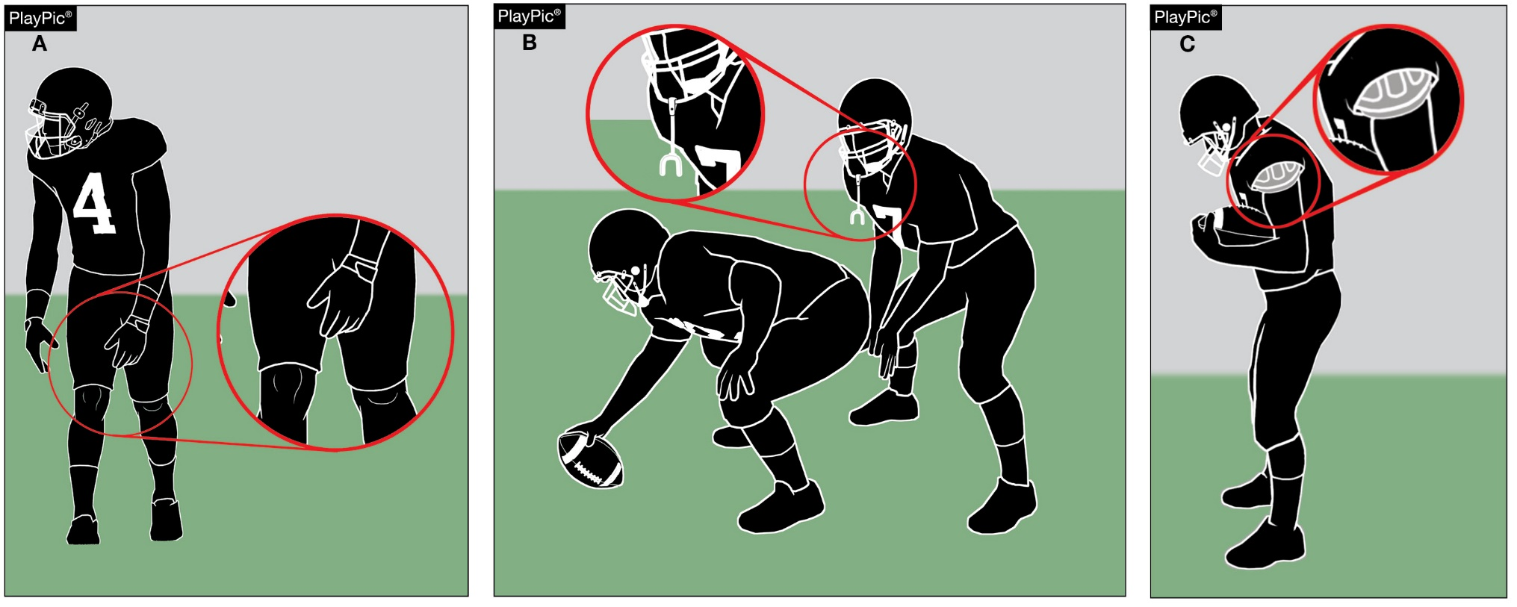
ILLEGAL AND IMPROPERLY WORN PLAYER EQUIPMENT
Improperly worn equipment pertains to all equipment that is otherwise legal but not worn as intended. Examples include pants not covering the knees, tooth and mouth protectors not being worn as play starts and shoulder pads not properly covered by the jersey.
Notes:
Illegal and Improperly Worn Player Equipment (Point of Emphasis) continued:
See comments on slide

Slide 64
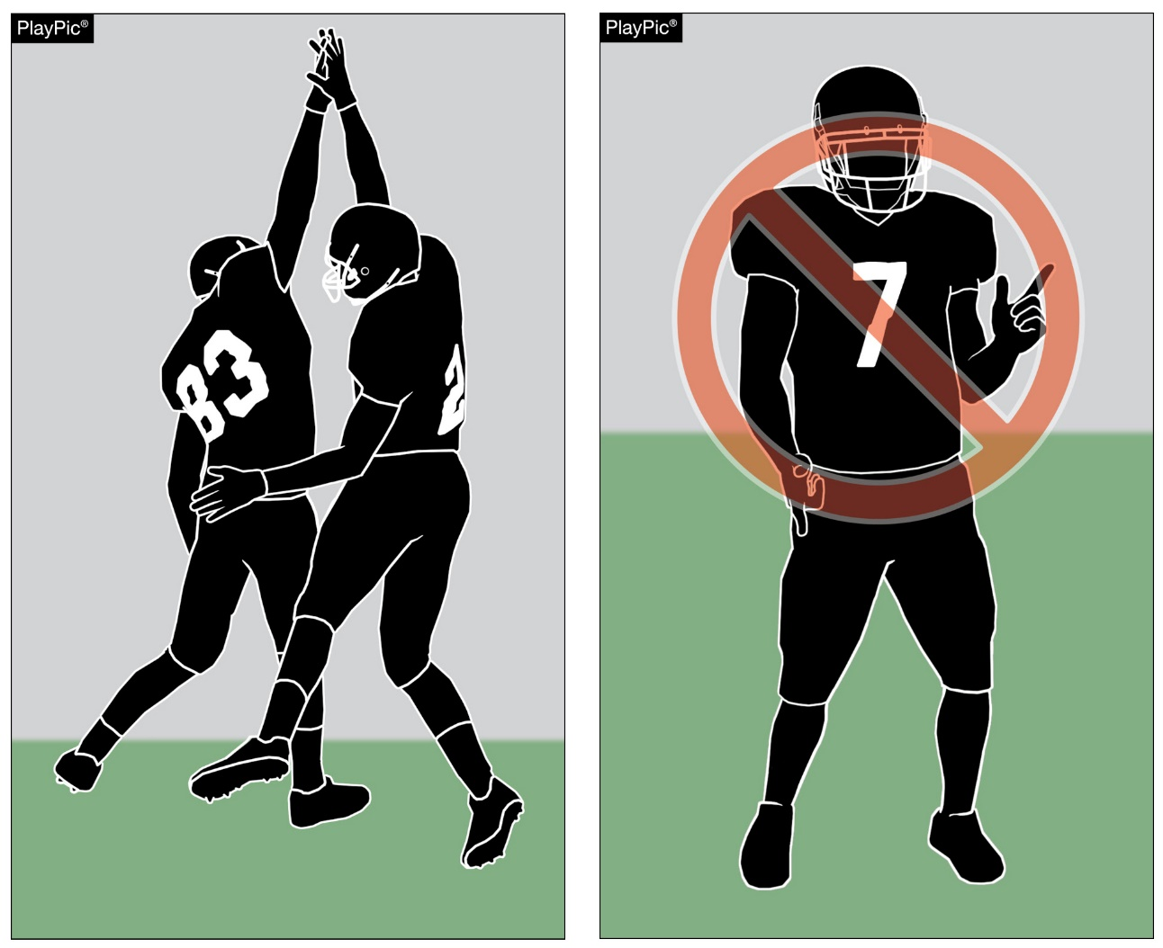
SPORTSMANSHIP
In determining whether an action rises to the level of an unsportsmanlike conduct foul, game officials should allow for brief, spontaneous, emotional reactions at the end of a play. However, game officials should penalize acts that are prolonged, choreographed or directed at an opponent.
Notes:
Sportsmanship (Point of Emphasis):
Unsportsmanlike conduct is incompatible with the values of education-based athletics. As unsporting acts increase at the college and professional levels, all stakeholders must work together to ensure high school football embodies the highest principles of sportsmanship and fundamental ethics of competition.
The focus of high school football is on the team – not the individual. The “individual over team” emphasis is contrary to the mission of education-based sports.
High school football is a game of extreme emotion played by exceptionally talented teenagers. Game officials should not be overly technical in applying the rules, but they should always be aware of conduct that does not exemplify sportsmanship. In determining whether an action rises to the level of a foul, game officials should allow for brief, spontaneous, emotional reactions at the end of a play. However, game officials should penalize acts that are prolonged, choreographed, and directed at an opponent.
The following actions are unsportsmanlike conduct that should be penalized without warning: demonstrations of violence such as brandishing guns and throat slashes, rehearsed poses, gestures with sexual connotation, dunking the ball over the crossbar, removal of helmet to celebrate or protest, dancing, somersaults or flips, and spiking or spinning the ball. Any act that is clearly intended to taunt, demean or show disrespect to an opponent or the game should be penalized.
The actions noted above are unsporting and contrary to the values of education-based athletics. The focus must remain on student-athletes, the values of team success, celebrating victory with class, and enduring loss with dignity.

Slide 65
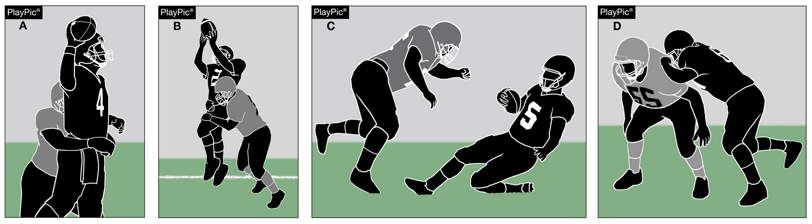
DEFENSELESS PLAYER/TARGETING
A defenseless player is a player who, because of his physical position and focus of concentration, is especially vulnerable to injury. The player remains defenseless until the player’s physical position and focus of concentration allows the player to have a chance to protect himself. Defenseless players include (A) passers, (B) receivers, (C) sliding runners, and (D) those illegally blocked from the blindside.
Notes:
Defenseless Player / Targeting (Point of Emphasis):
A defenseless player is a player who, because of physical position and focus of concentration, is especially vulnerable to injury. The player remains defenseless until the player’s physical position and focus of concentration allows the player to have a chance to protect themselves or brace, at least partially, for contact.
The most common types of defenseless players include passers, receivers, sliding runners, runners whose forward progress is stopped, players out of the play and players who are illegally blocked from the blindside. For added defenseless player clarifications, please refer to 2.32.16 COMMENT and CHART in the 2025 NFHS Football Case Book.
A player is defenseless based on the player’s own position and concentration. It is not determined by another player’s actions. When the wrap-up tackle was added to the definition of defenseless player as it relates to contact on a defenseless receiver, it created confusion because this highlighted action by another player. Thus, the forceful contact against a defenseless receiver portion of Rule 2 (definitions) has been relocated to Rule 9 (conduct of players/penalty). By moving the wrap-up tackle portion of the defenseless player guidelines to Rule 9, it clearly limits the contact to a defenseless offensive or defensive receiver, to incidental contact that is a result of making a play on the ball, contact initiated with open hands, or an attempt to tackle by wrapping arm(s) around the receiver.
A major focus of the NFHS Football Rules Committee is to promote uniform enforcement of illegal contact on defenseless players across the country. We urge all coaches and game officials to study the rules, watch and share video, and have discussions with one another about what constitutes legal and illegal contact. Furthermore, a review of targeting provisions is crucial for minimizing risk for all players.
It is imperative that players clearly comprehend what contact is acceptable and be able to recognize when an opponent is considered defenseless. Players must realize that the responsibility for making legal contact resides with the person initiating the contact.
Game officials must demonstrate a broad awareness of what contact is necessary to make a legal block or tackle and contact considered excessive and, in some cases, flagrant. Forceful contact that is avoidable should not be tolerated by coaches or game officials. When in doubt, game officials should throw a flag for illegal personal contact and should be supported in doing so.
The long-term success of high school football is linked to risk minimization. Coaches, game officials, players and administrators share the responsibility to eliminate targeting and illegal contact against defenseless players from our great game.

Slide 66
2024-2025 NFHS FOOTBALL GAME OFFICIALS MANUAL UPDATE

Slide 67
40 / 25 SECOND PLAY CLOCK
Game Officials Manual
40-SECOND PLAY CLOCK
  Rationale: To have a more consistent time period between downs. The NFHS approved situations where 40 seconds will be placed on the play clock. The rule defines when 40 seconds will be placed on the play clock and when 25 seconds will be placed on the play clock.
40-SECOND PLAY CLOCK will be in use for all NYSPHSAA Varsity level games.
40-SECOND PLAY CLOCK will be used for 5-man or above crews.
The game clock and play clock are only “official” when a certified NYSACFO official is the respective clock operator.
Notes:
Comment on Slide:
The following football points of emphasis were selected by the NFHS Football Game Officials Manual Committee for the 2024-2025 high school football seasons. These three football points of emphasis from the NFHS Football Game Officials Manual Committee, need to be stressed to all coaches, game officials, players, parents, school administrators, appropriate health-care professionals and all others who have an interest in high school football.

Slide 68
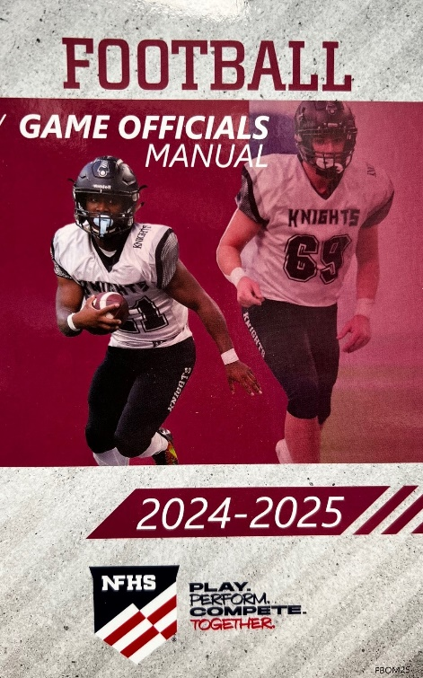
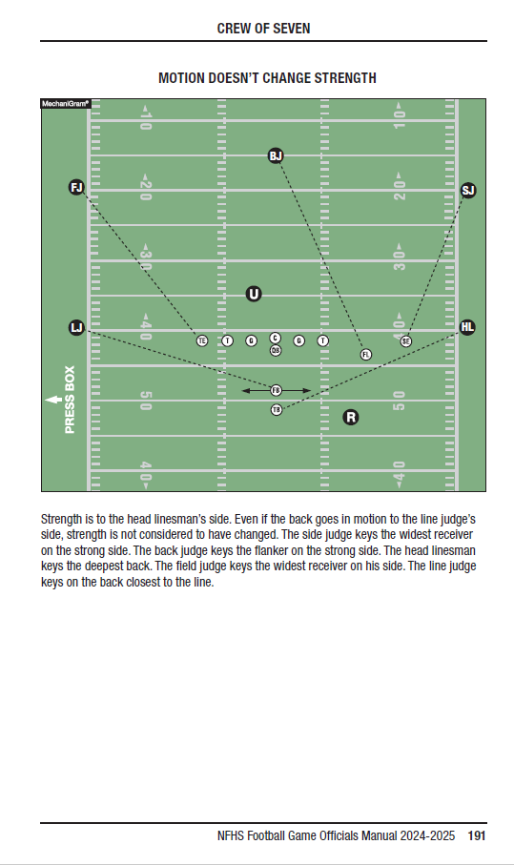
2024-2025
Nfhs football game officials manual
Game Officials Manual
The 2024-2025 NFHS Football Game Officials Manual was completely redone by the NFHS Football Game Officials Manual Committee in 2024.
2025 was a non-print year for the NFHS Football Game Officials Manual.
2026 will be a print year for the 2026-2027 NFHS Football Game Officials Manual.
Possible Football Mechanics Officiating Changes the Manual Committee will be considering in 2026.
November 1, 2025 – Due Date for Proposed Football Mechanics Officiating Changes.
Notes:
Comment on Slide:
See comments on the slide.

Slide 69
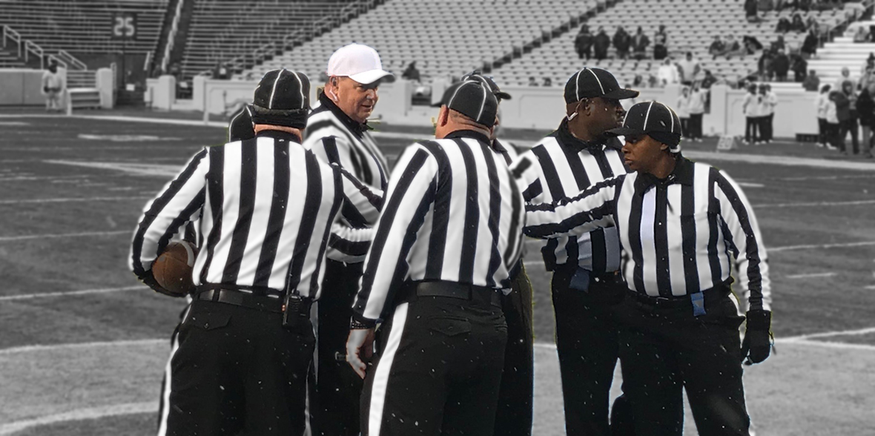
2024-2025 nfhs football game officials manual committee points of emphasis
Game Officials Manual
1. Pregame Administration
2. Clock Management
3. The Importance of Dead-Ball Officiating
Notes:
Comment on Slide:
The following football points of emphasis were selected by the NFHS Football Game Officials Manual Committee for the 2024-2025 high school football seasons. These three football points of emphasis from the NFHS Football Game Officials Manual Committee, need to be stressed to all coaches, game officials, players, parents, school administrators, appropriate health-care professionals and all others who have an interest in high school football.

Slide 70
2025-26 NFHS FOOTBALL INFORMATION

Slide 71
2026 nfhs football rule change proposal online form
Due:
November 1, 2025
Must be submitted to your state association office for approval.
Notes:
Comment on Slide:
ALL 2026 NFHS Football Rule Change Proposal Online Forms must first go through the state association office before it can be sent to the NFHS.
Only member state associations, football coaches and football game officials approved by the member state association, members of the NFHS Football Rules Committee and the NFHS can submit football rule change online proposal forms.
ALL 2026 NFHS Football Rule Change Online Proposal Forms must be submitted electronically online to the NFHS by November 1, 2025.

Slide 72
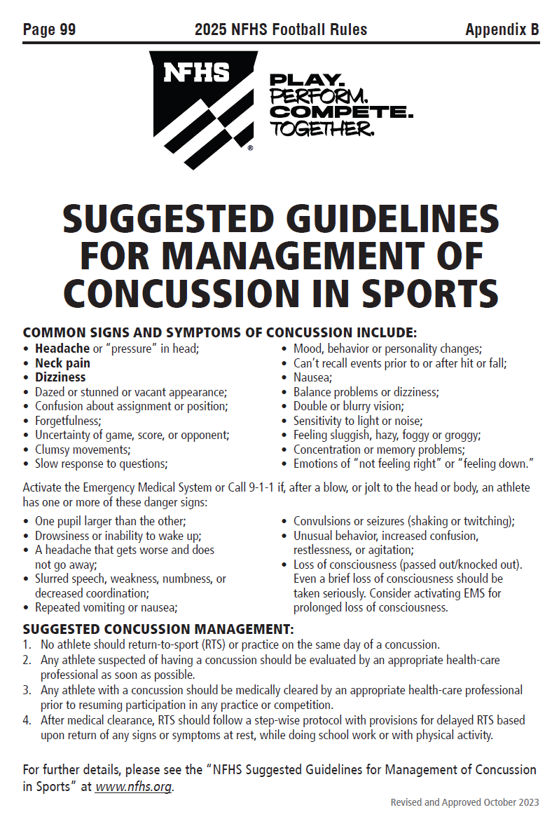
Nfhs suggested guidelines For management of concussion in sports
In the Appendix
in all of the
2025-26 NFHS
Rules Book
Notes:
Comment on Slide:
The “NFHS Suggested Guidelines for Management of Concussion” is in the Appendix in all of the 2025-26 NFHS Rules Books and was developed by the NFHS Sports Medicine Advisory Committee (SMAC).

Slide 73
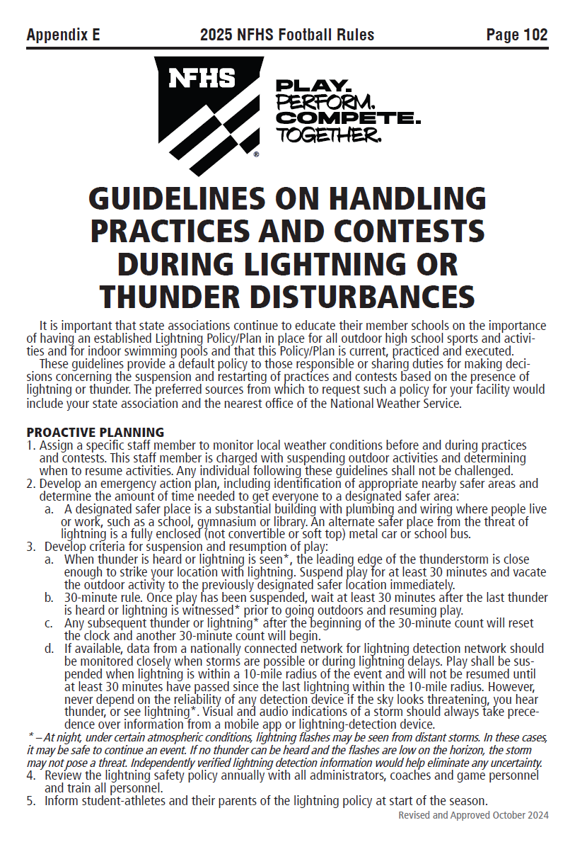
Nfhs guidelines on handling practices and contests during lightning or thunder disturbances
In Appendix E
in the
2025 NFHS
Football Rules Book
Notes:
Comment on Slide:
The “Nfhs guidelines on handling practices and contests during lightning or thunder disturbances” is in Appendix E in the 2025 NFHS Football Rules Book and was developed by the NFHS Sports Medicine Advisory Committee (SMAC).

Slide 74
Thank You !
EXCELLENCE
  BE Prepared to do your very best every game
  ”Strive for Excellence not Perfection”
CONSISTENCY
  Steadfast adherence to the approved officiating mechanics from the first game thru the last game, 1st Quarter thru the 4th Quarter, and from Section 1 thru Section 11
HAVE FUN
  Enjoy the Process of Learning the Rules and Mechanics, Enjoy the On-Field Challenges, Enjoy the Teamwork

